Slide 1

20392 - RICHLY BLEST - Title

Slide 2
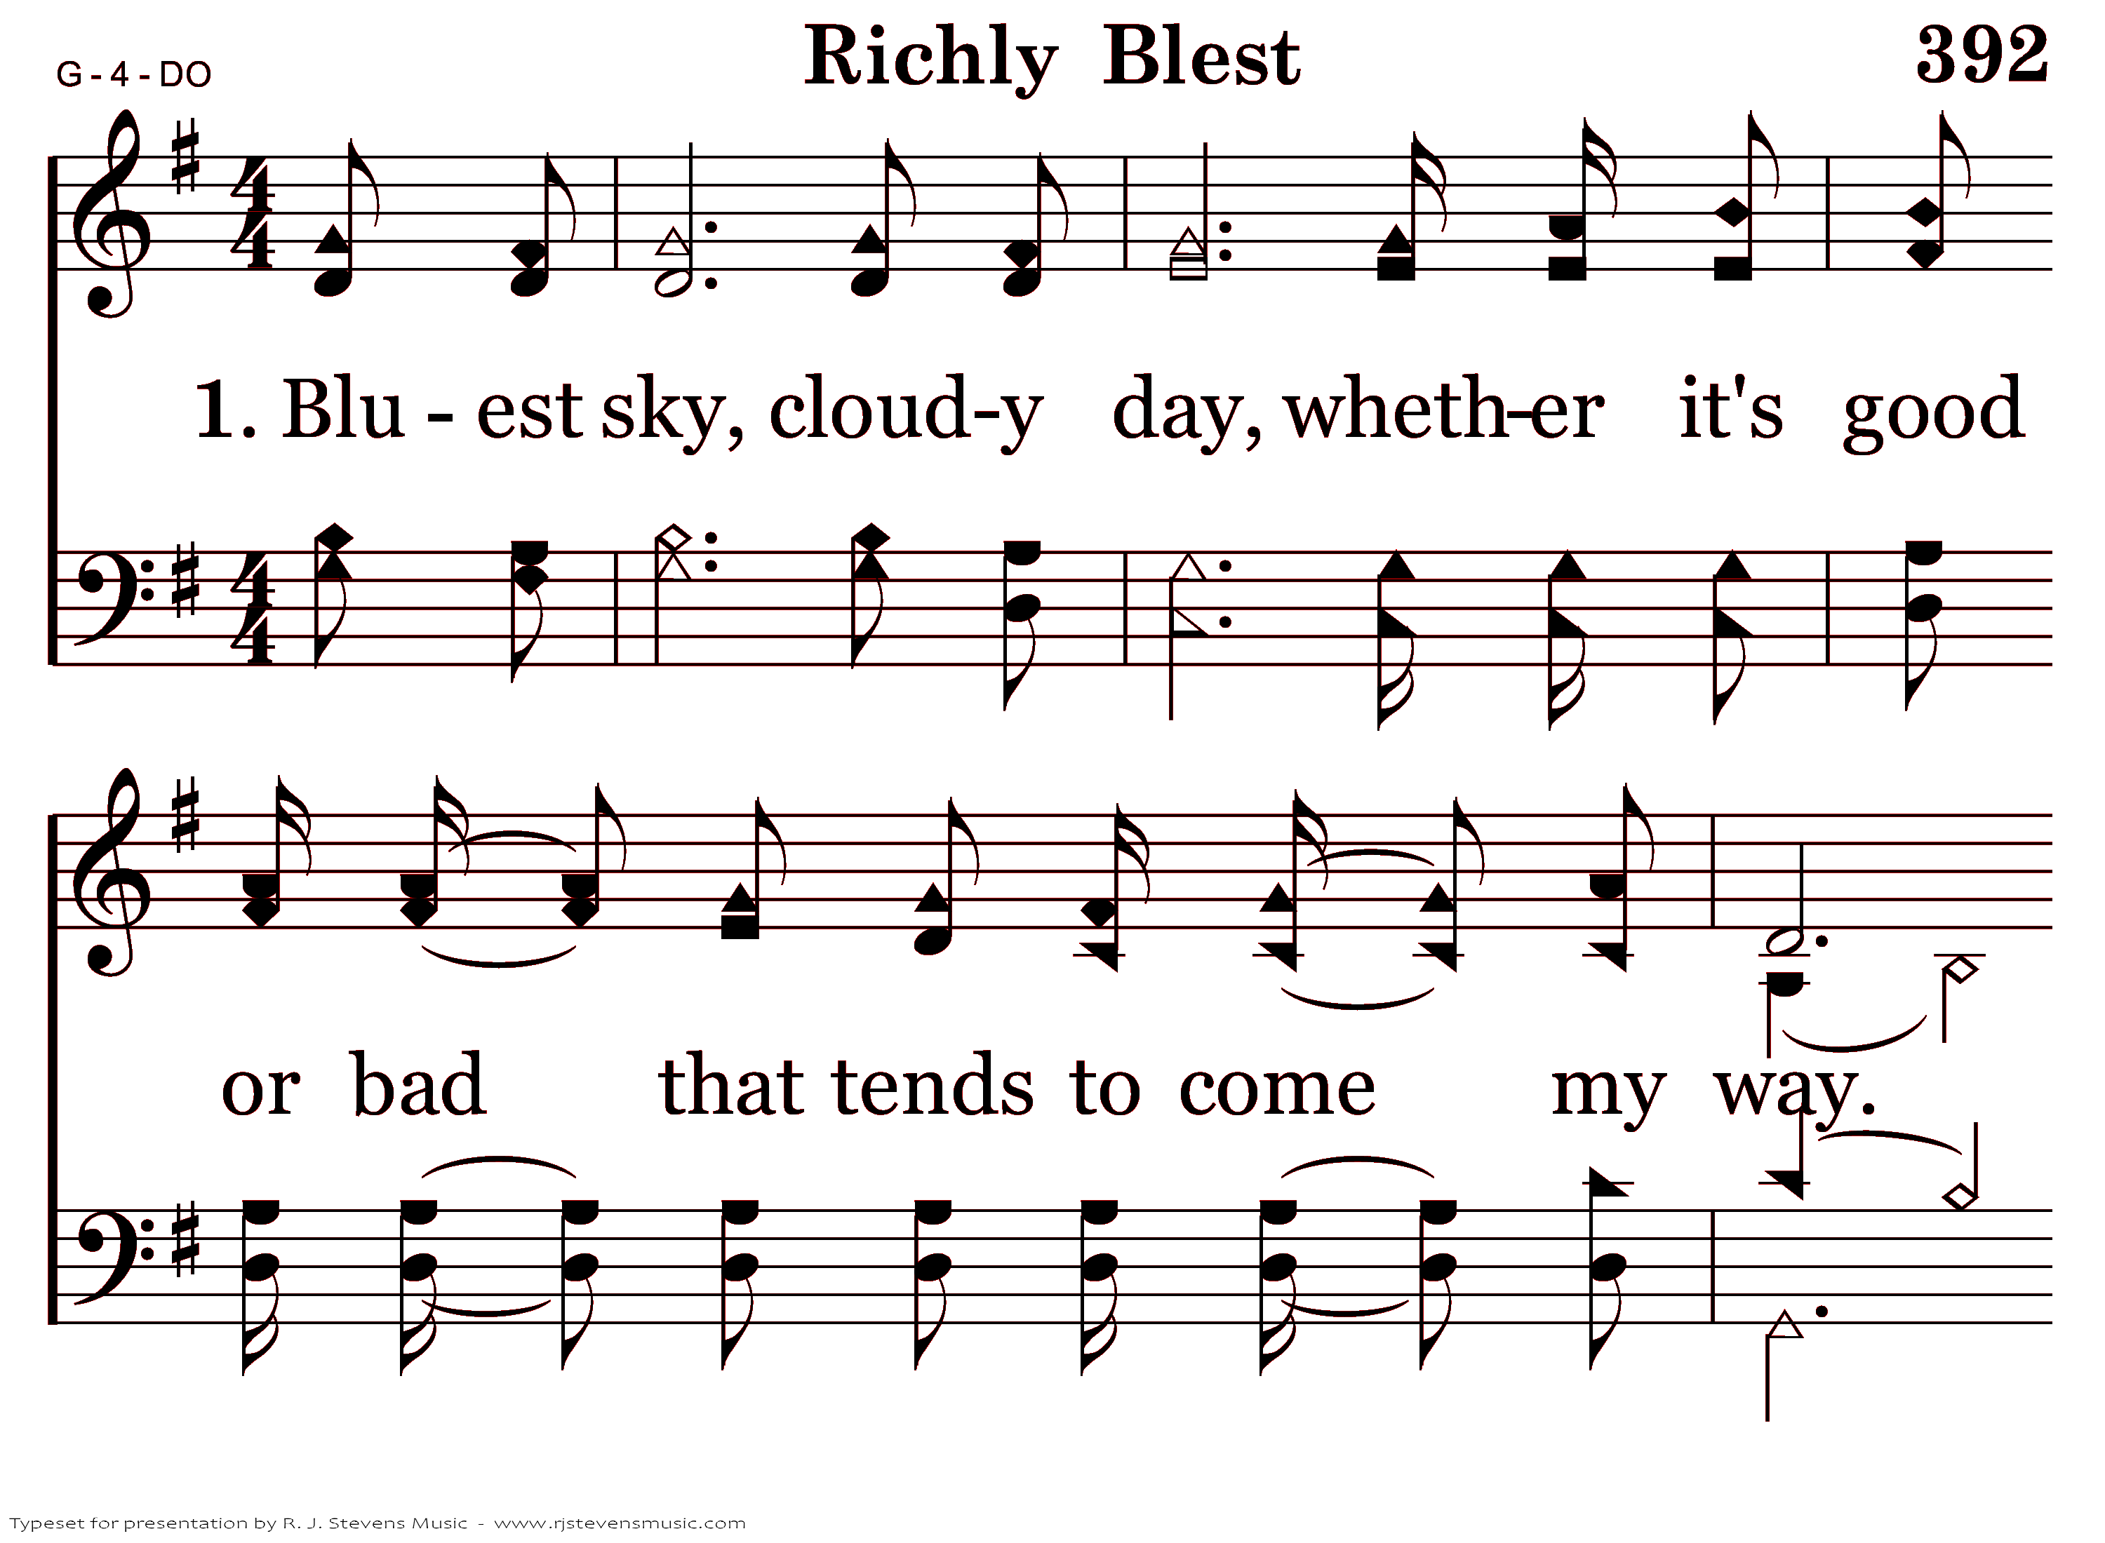
20392 - RICHLY BLEST - 1.1

Slide 3
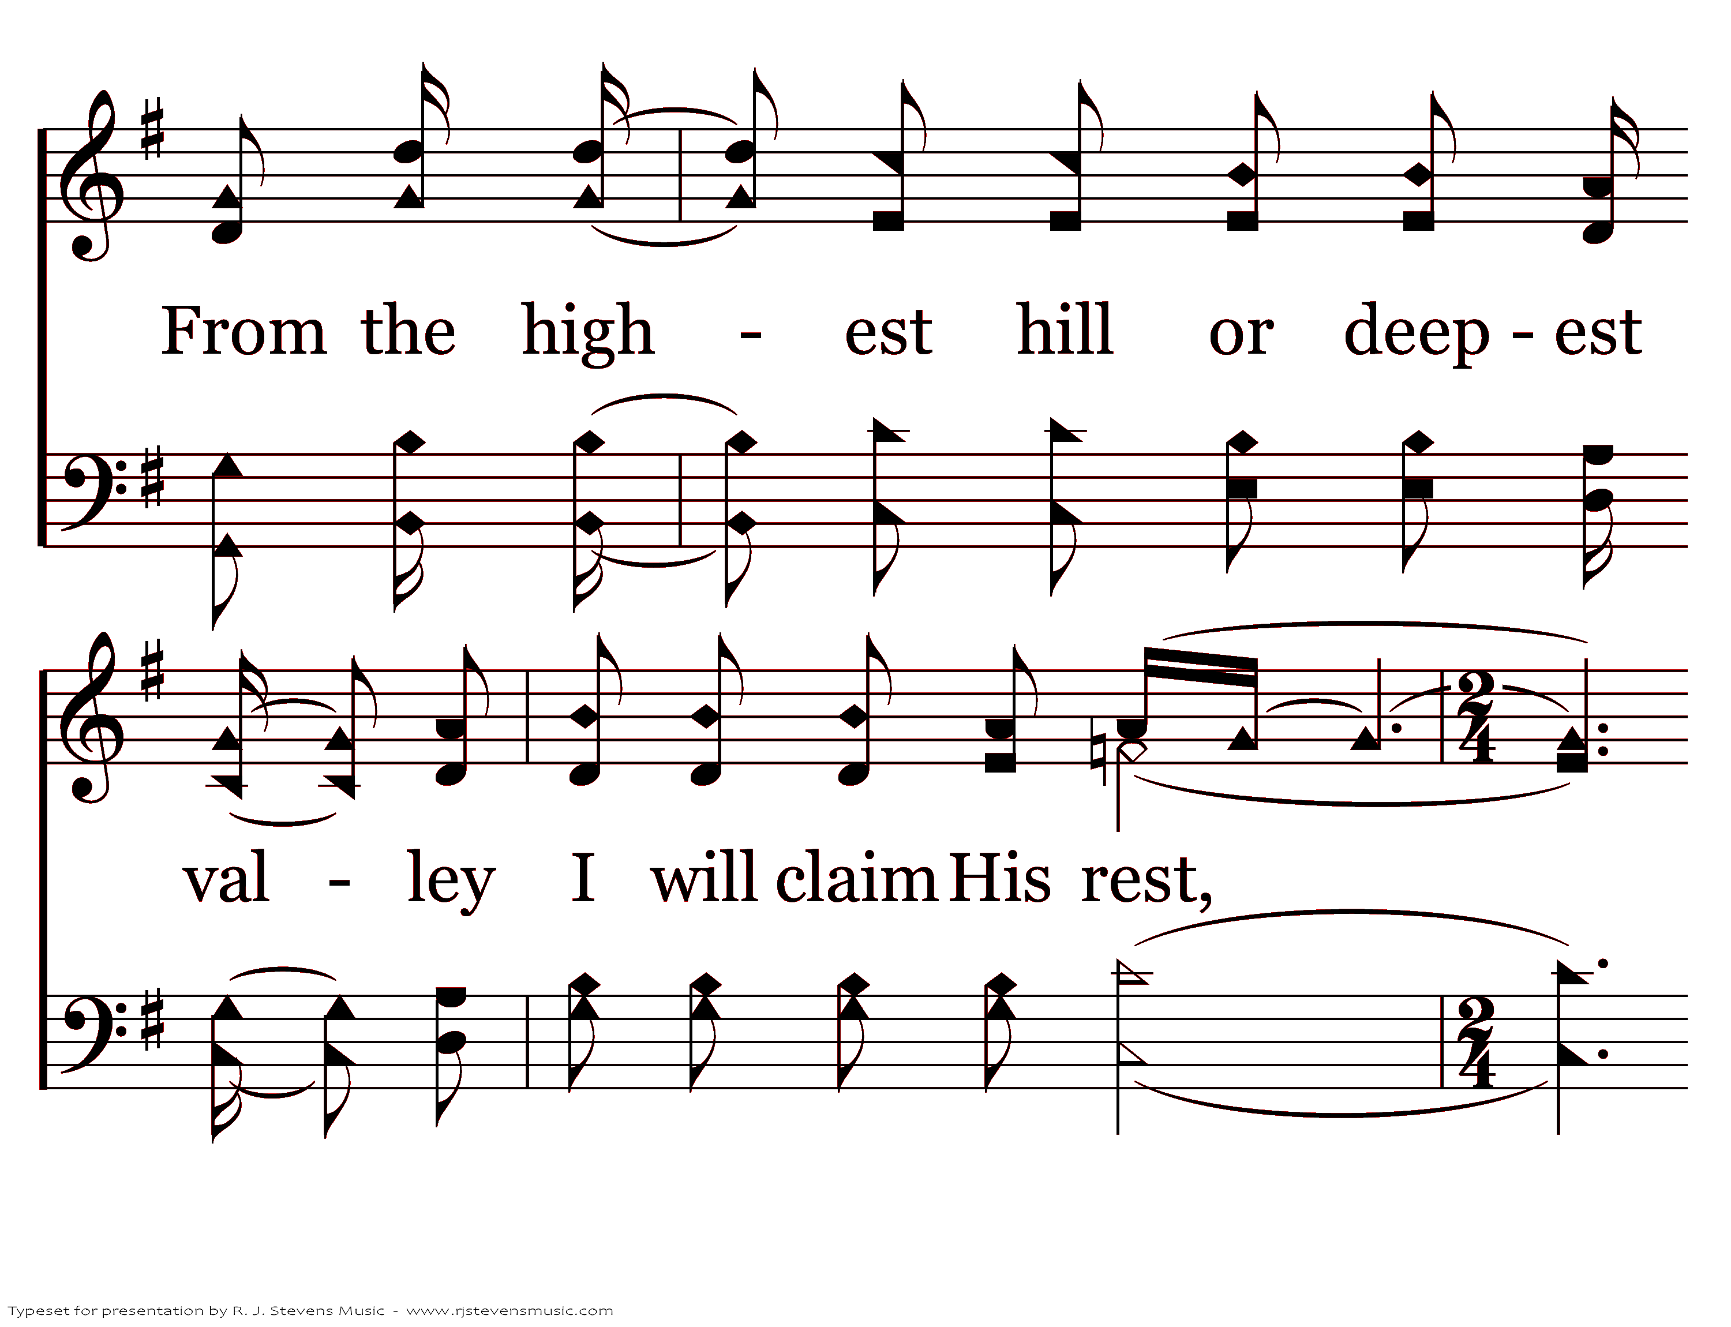
20392 - RICHLY BLEST - 1.2

Slide 4
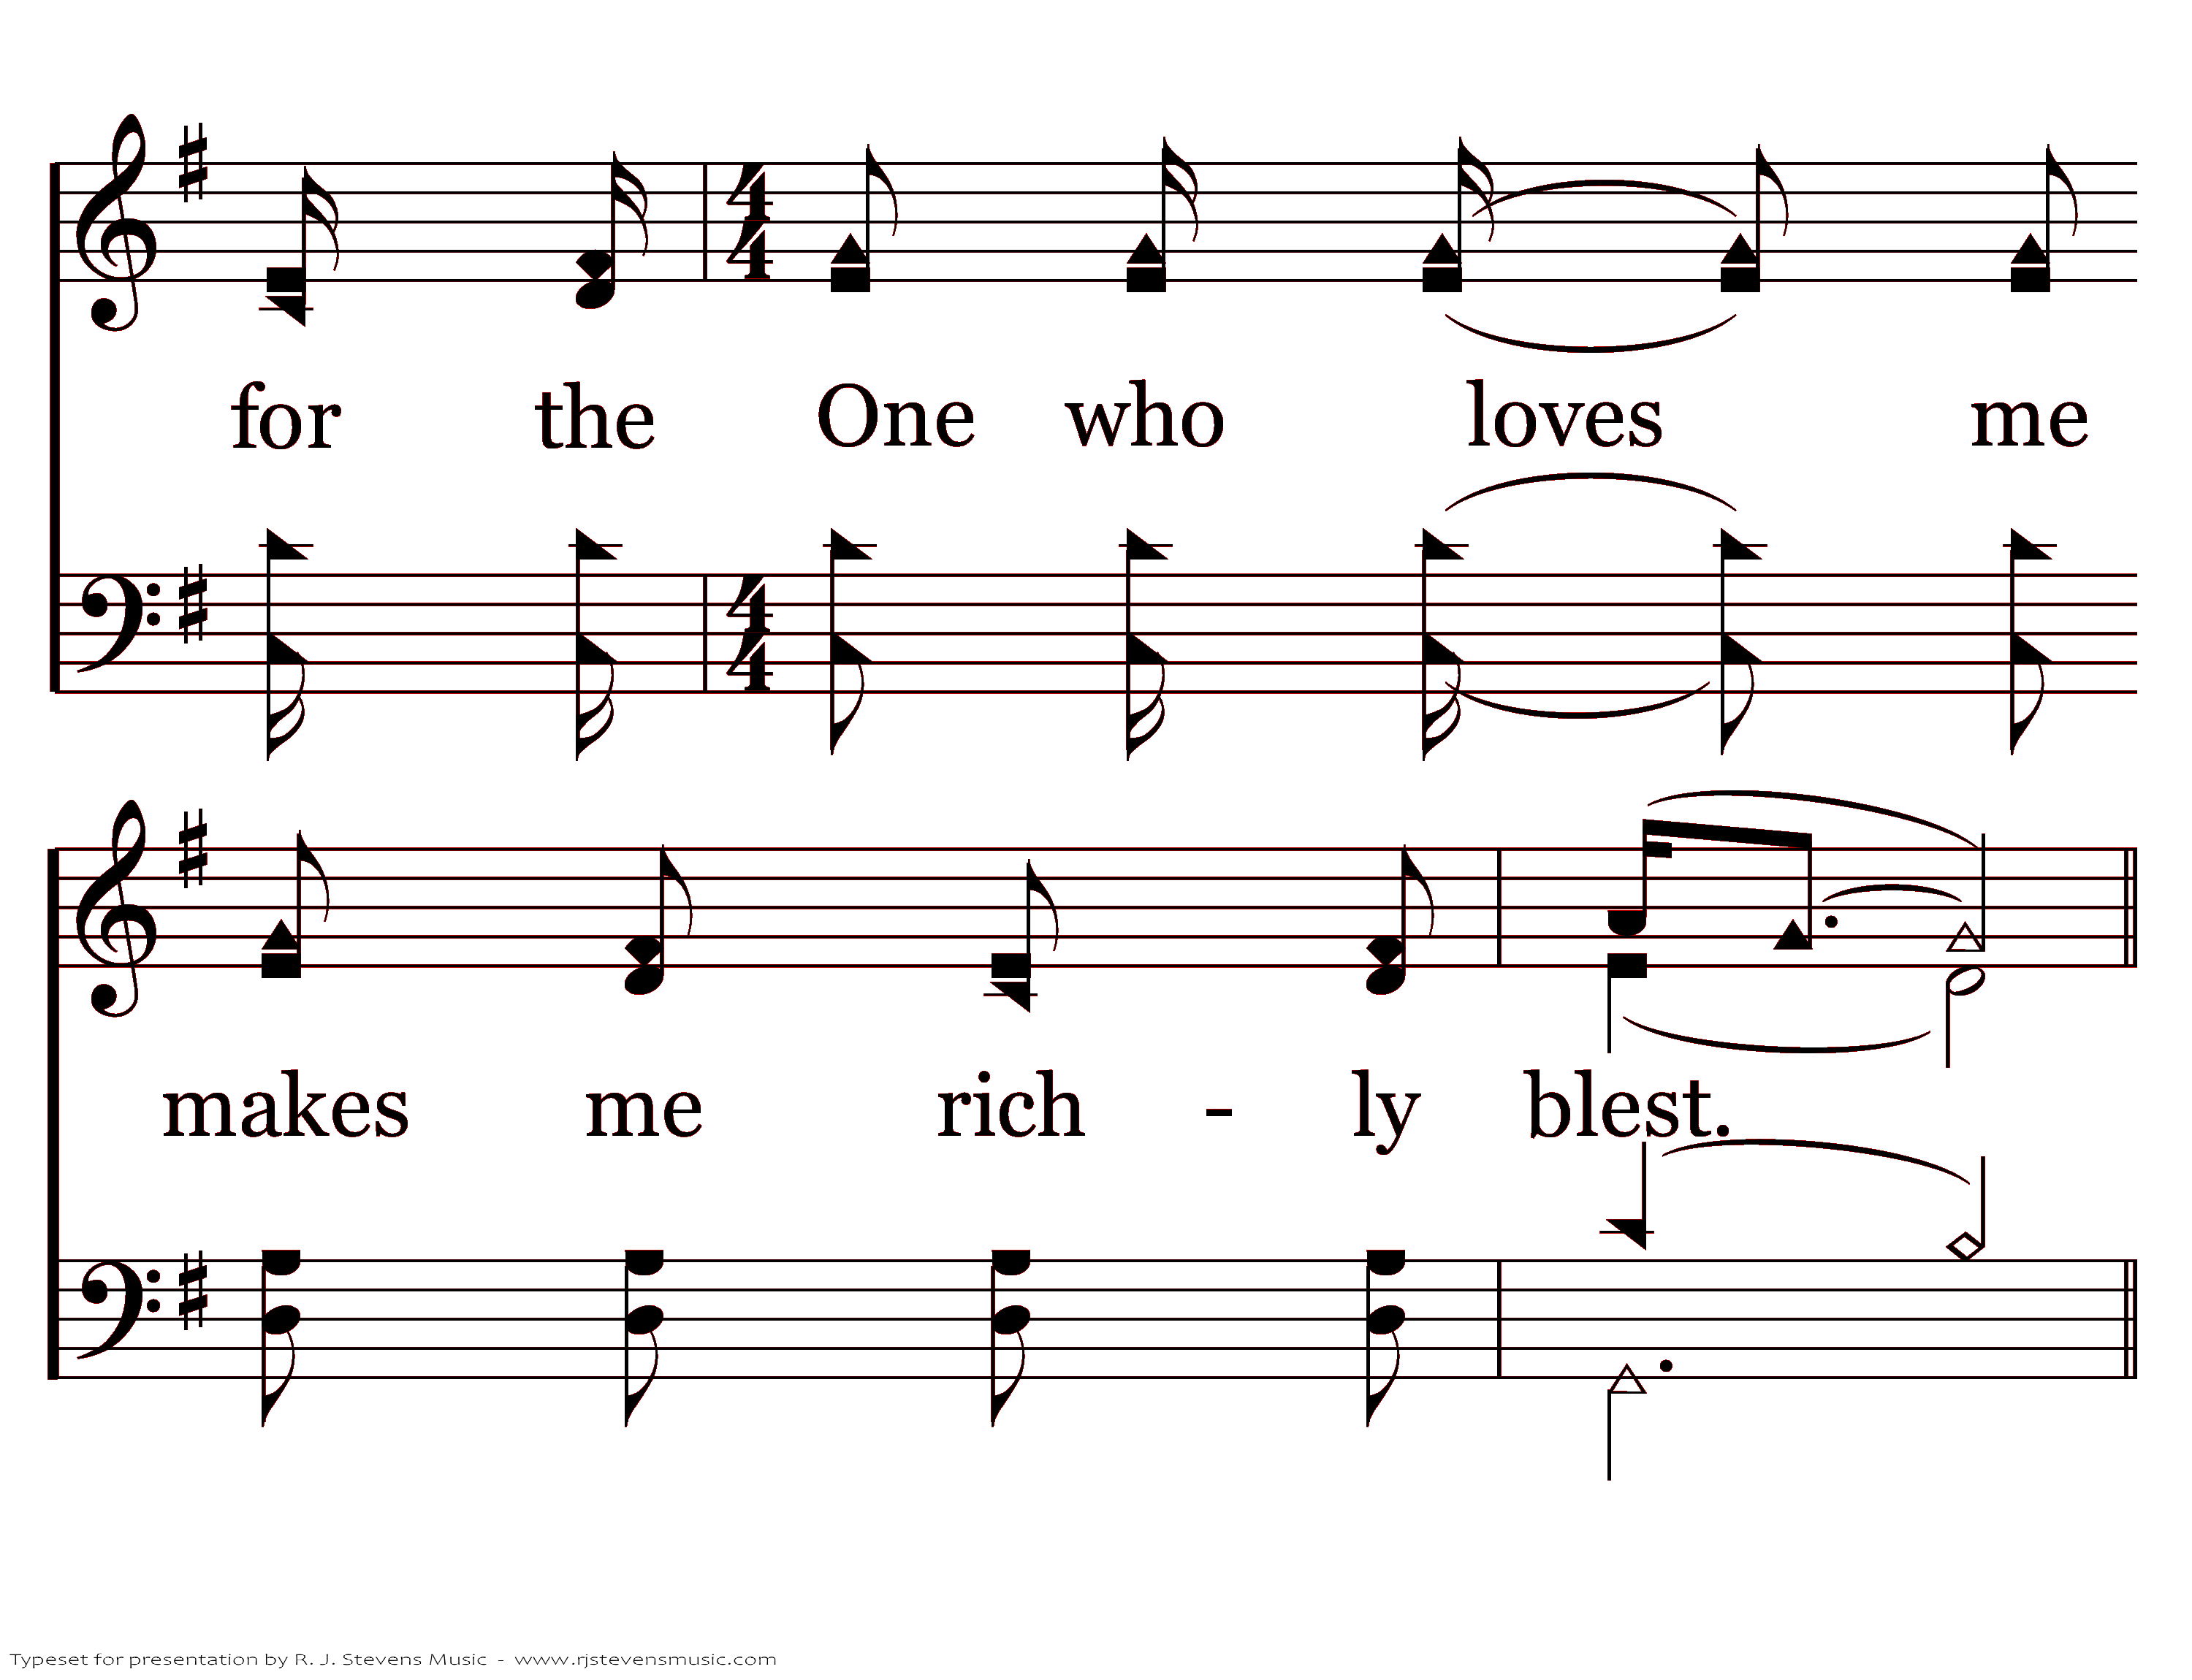
20392 - RICHLY BLEST - 1.3
End of Verse 1

Slide 5
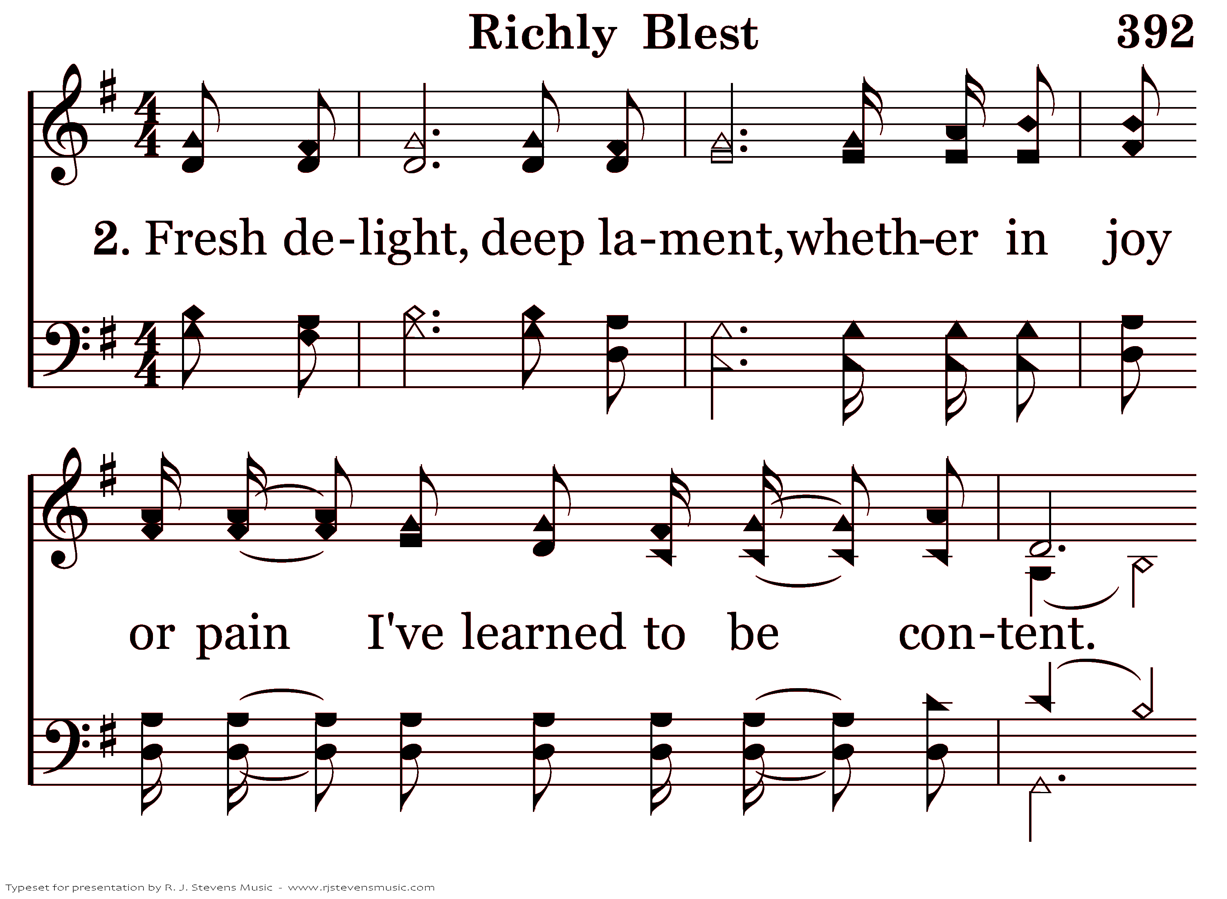
20392 - RICHLY BLEST - 2.1

Slide 6
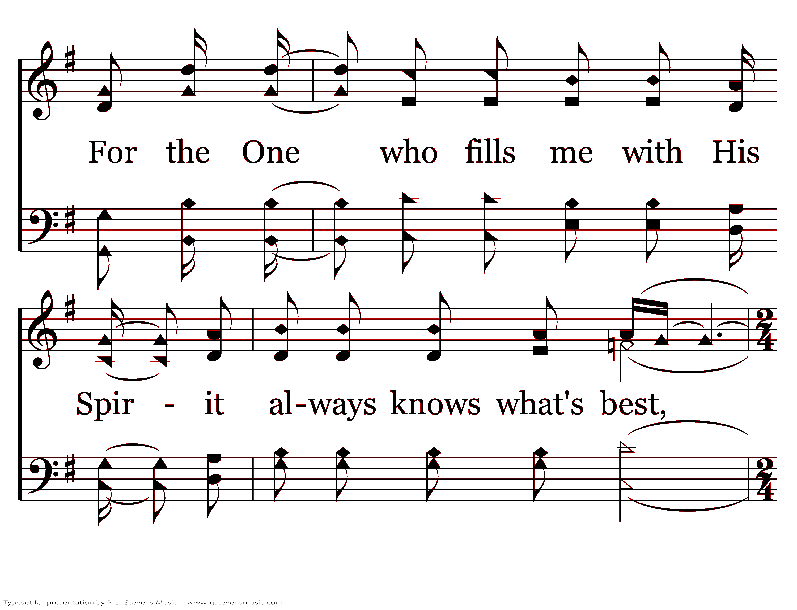
20392 - RICHLY BLEST - 2.2

Slide 7
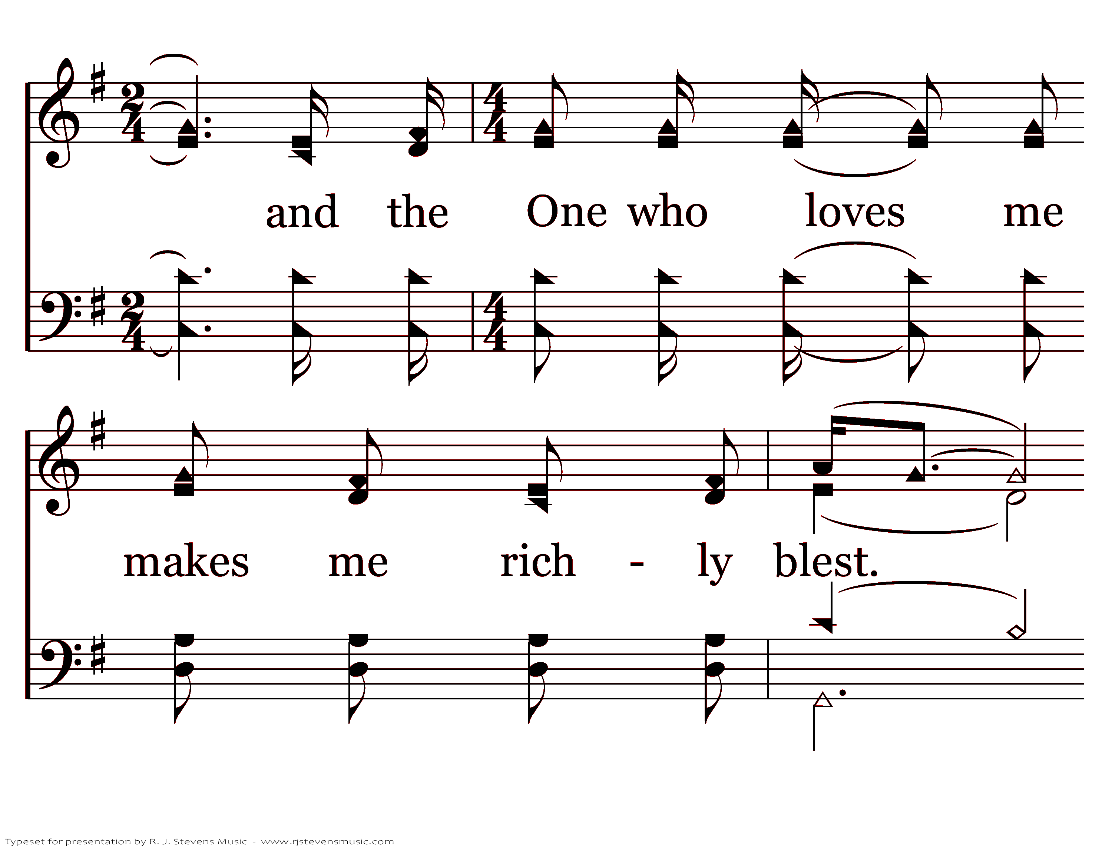
20392 - RICHLY BLEST - 2.3

Slide 8
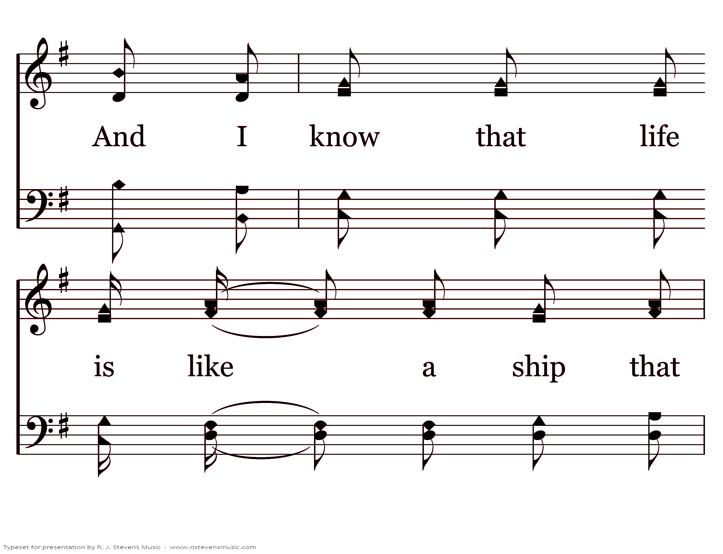
20392 - RICHLY BLEST - 2.4

Slide 9
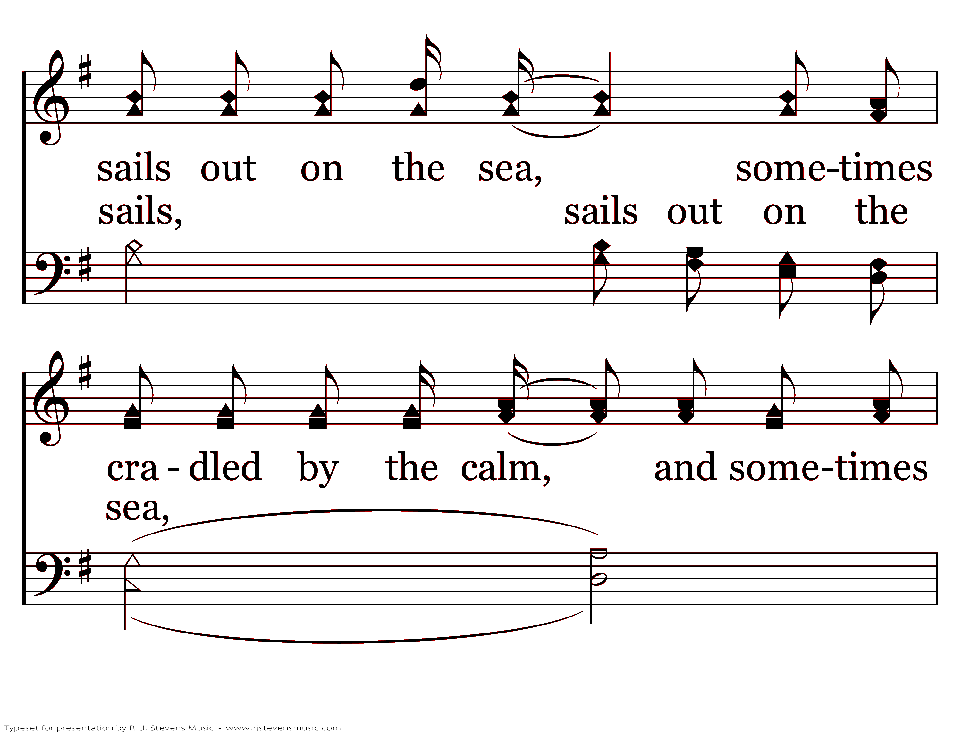
20392 - RICHLY BLEST - 2.5

Slide 10
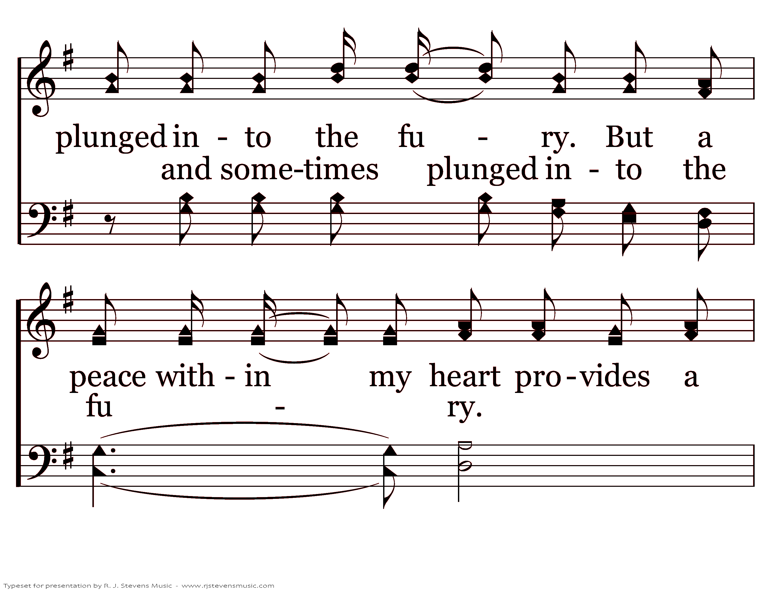
20392 - RICHLY BLEST - 2.6

Slide 11
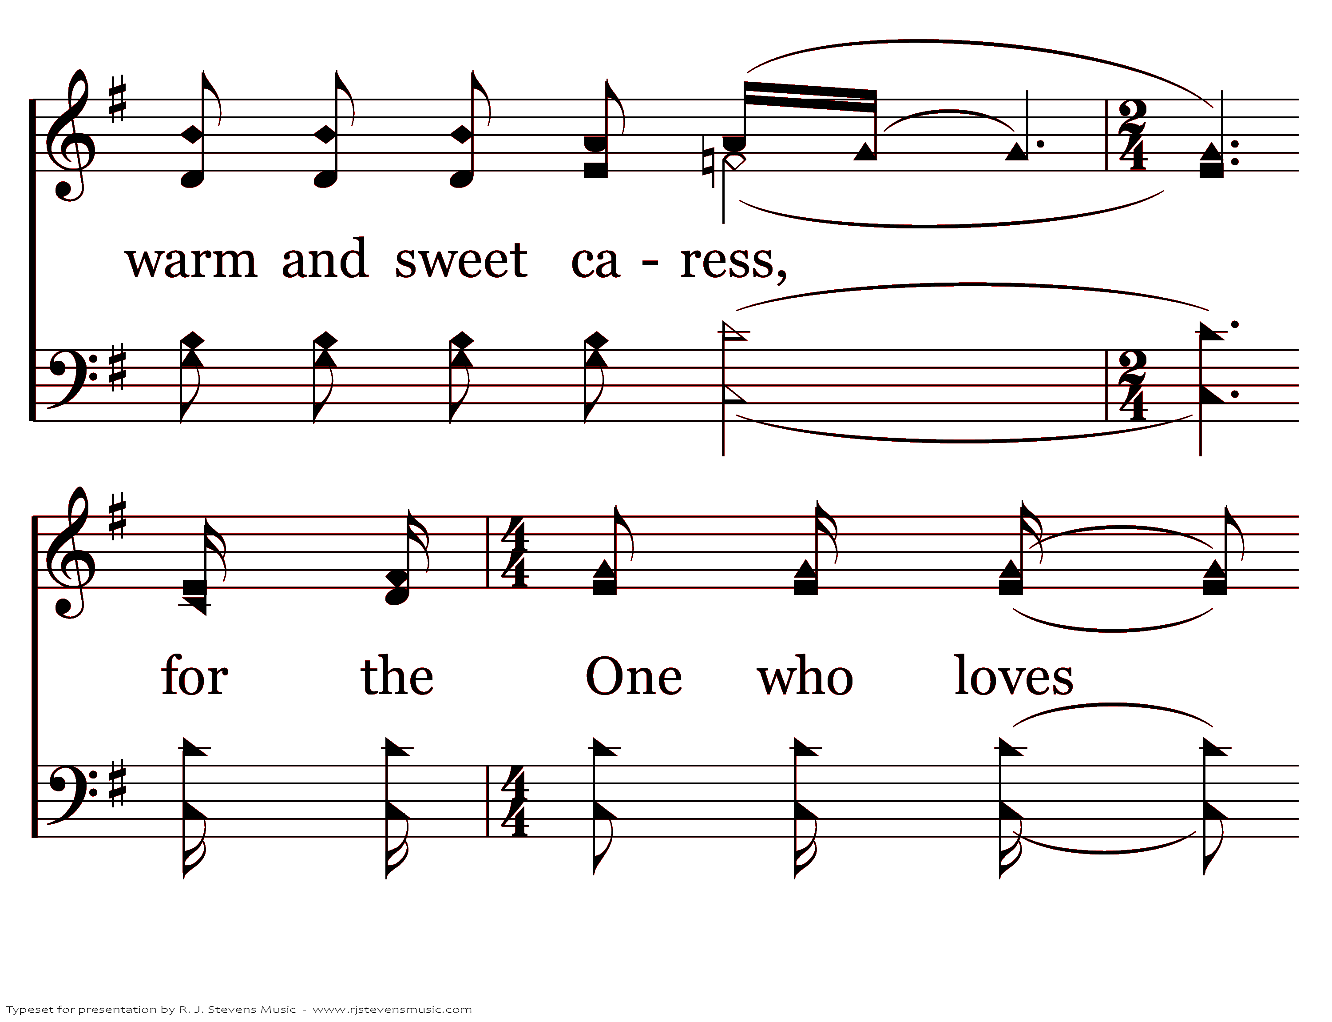
20392 - RICHLY BLEST - 2.7

Slide 12
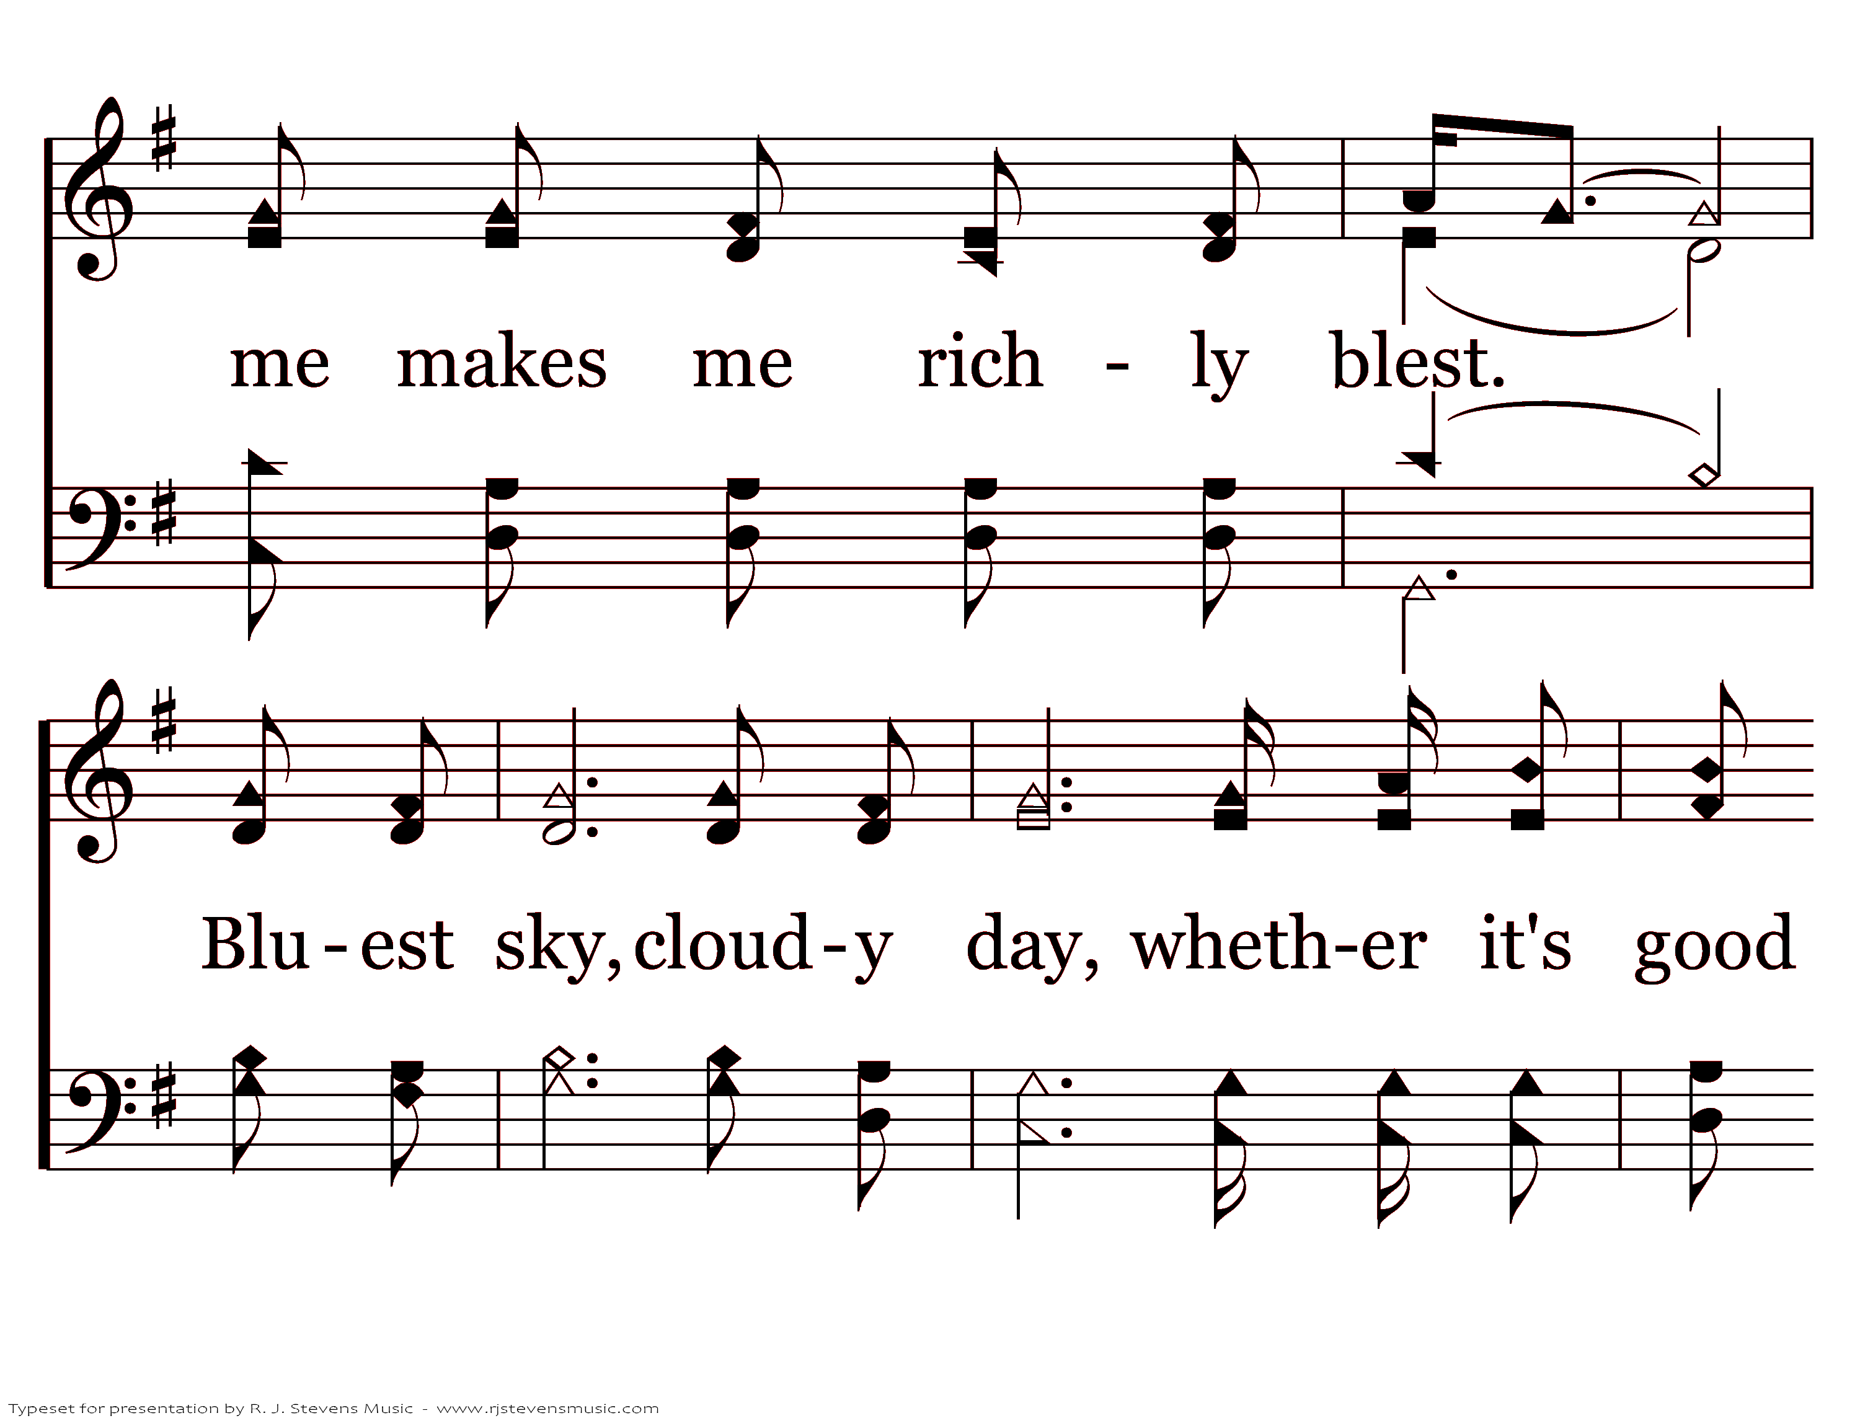
20392 - RICHLY BLEST - 2.8

Slide 13
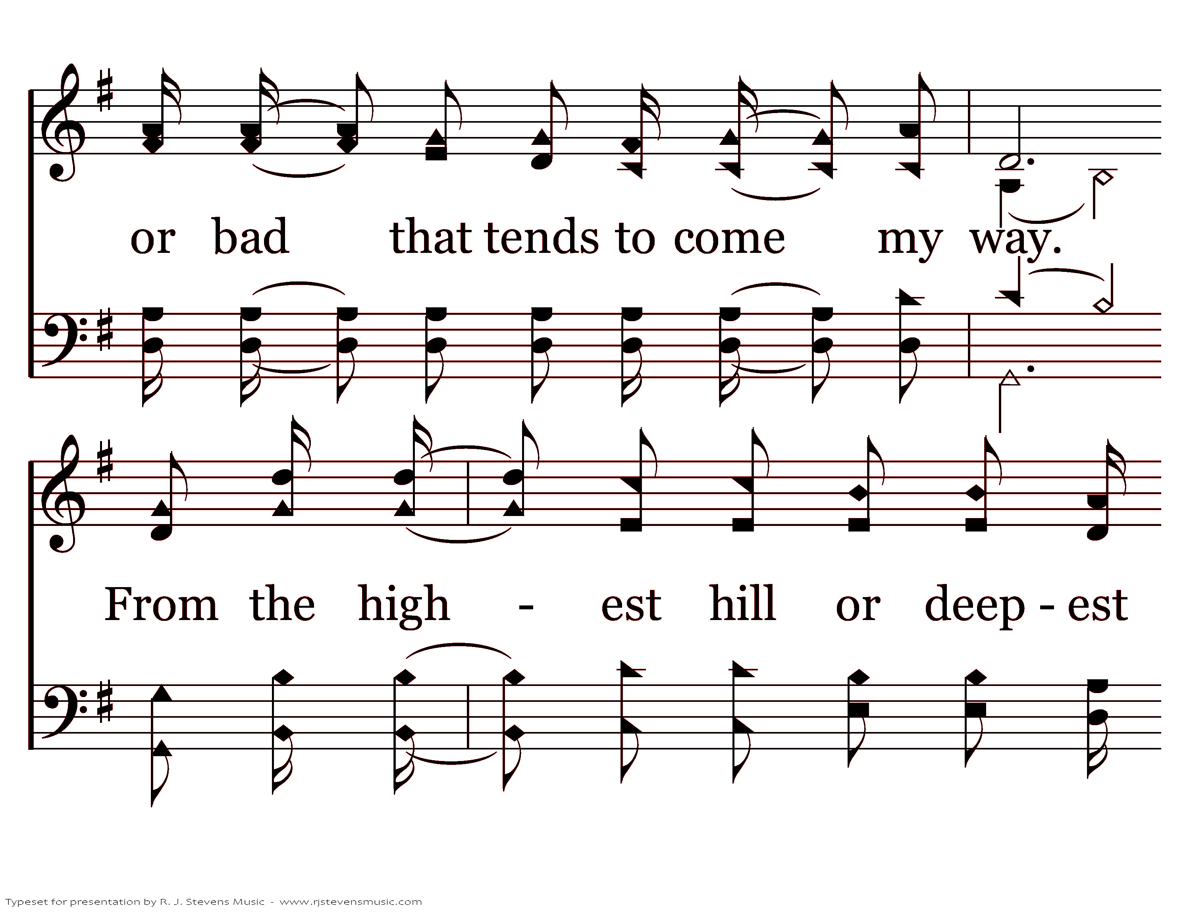
20392 - RICHLY BLEST - 2.9

Slide 14
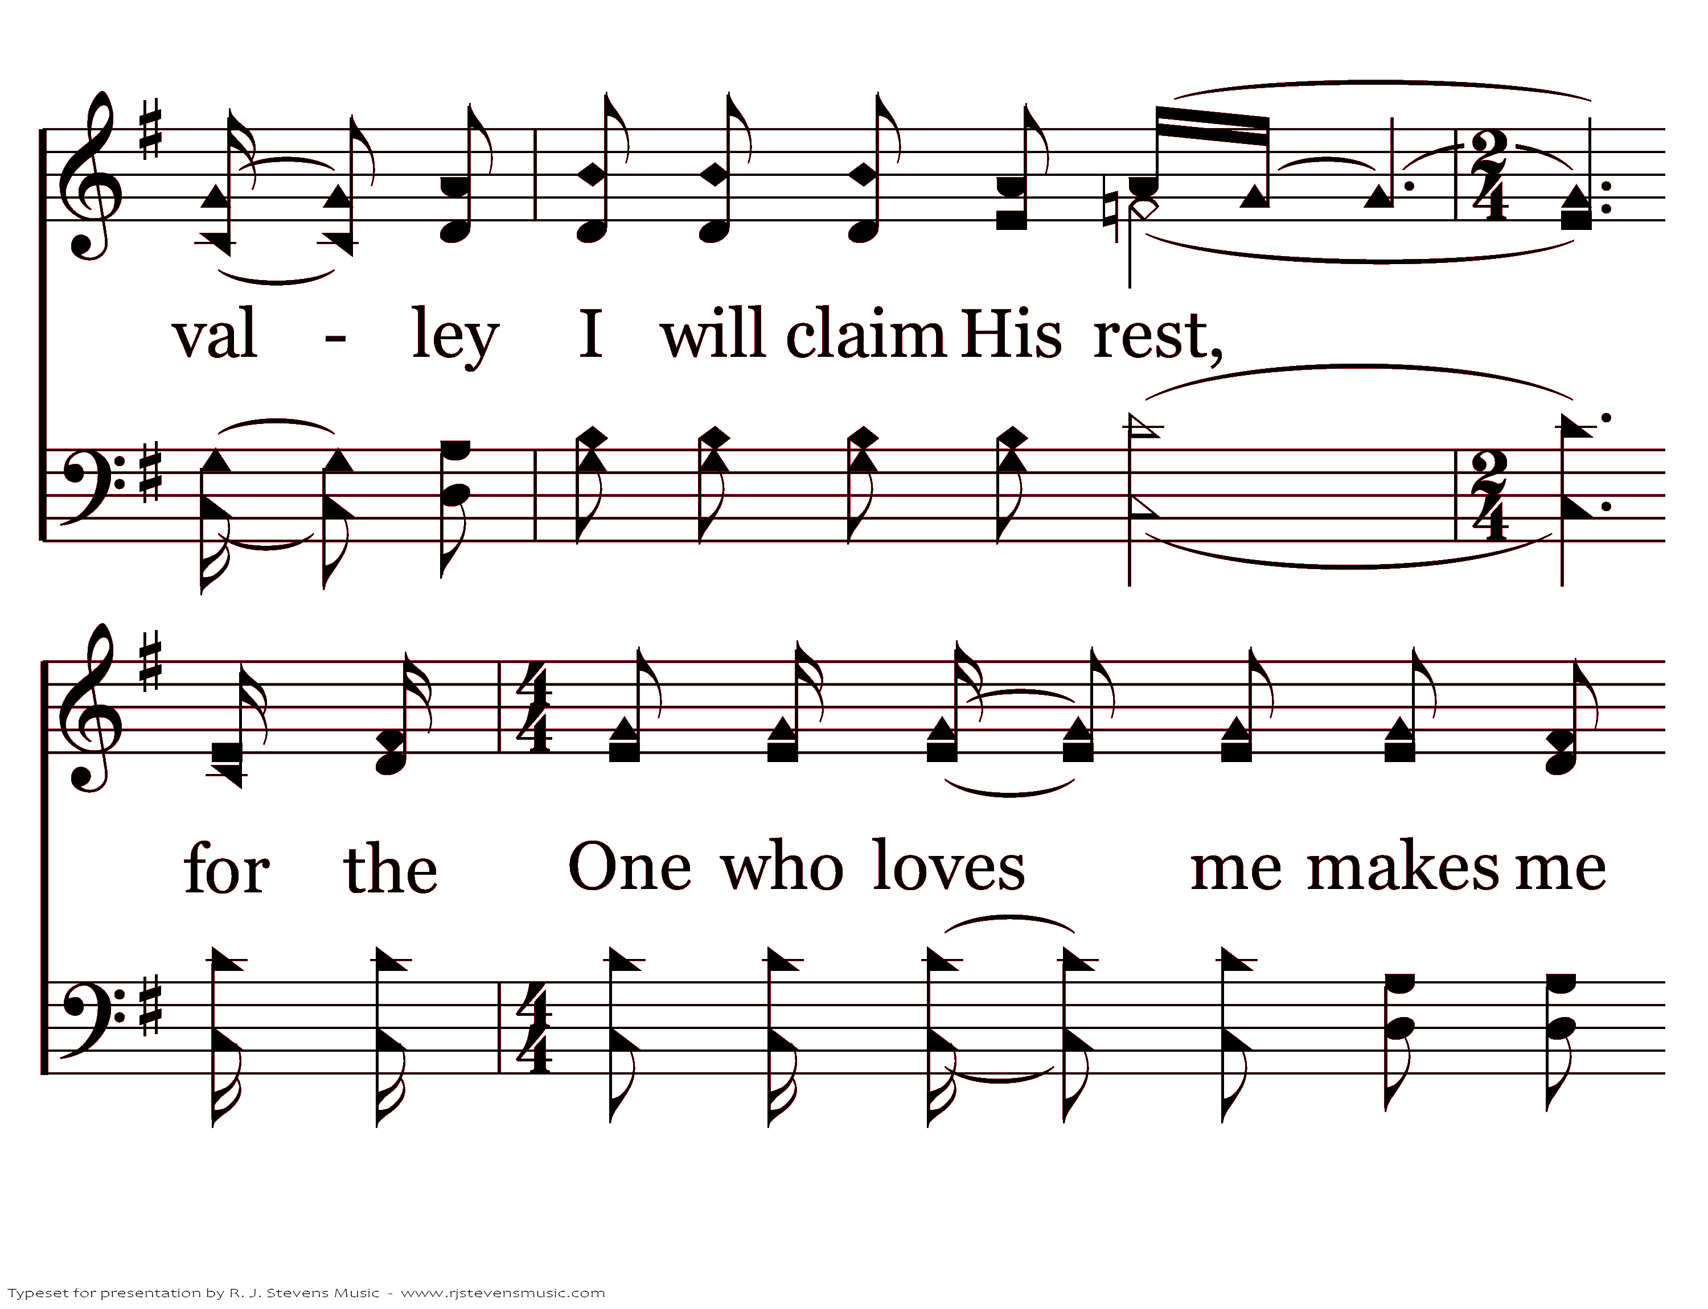
20392 - RICHLY BLEST - 2.10

Slide 15
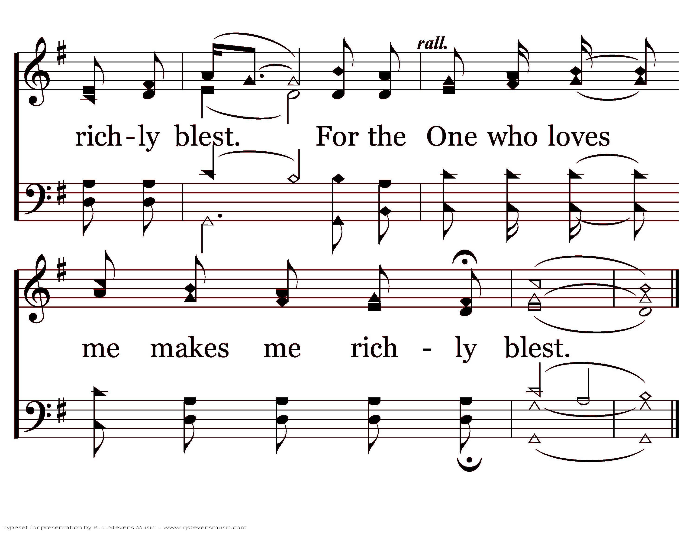
20392 - RICHLY BLEST - 2.11
End of Song

