Slide 1
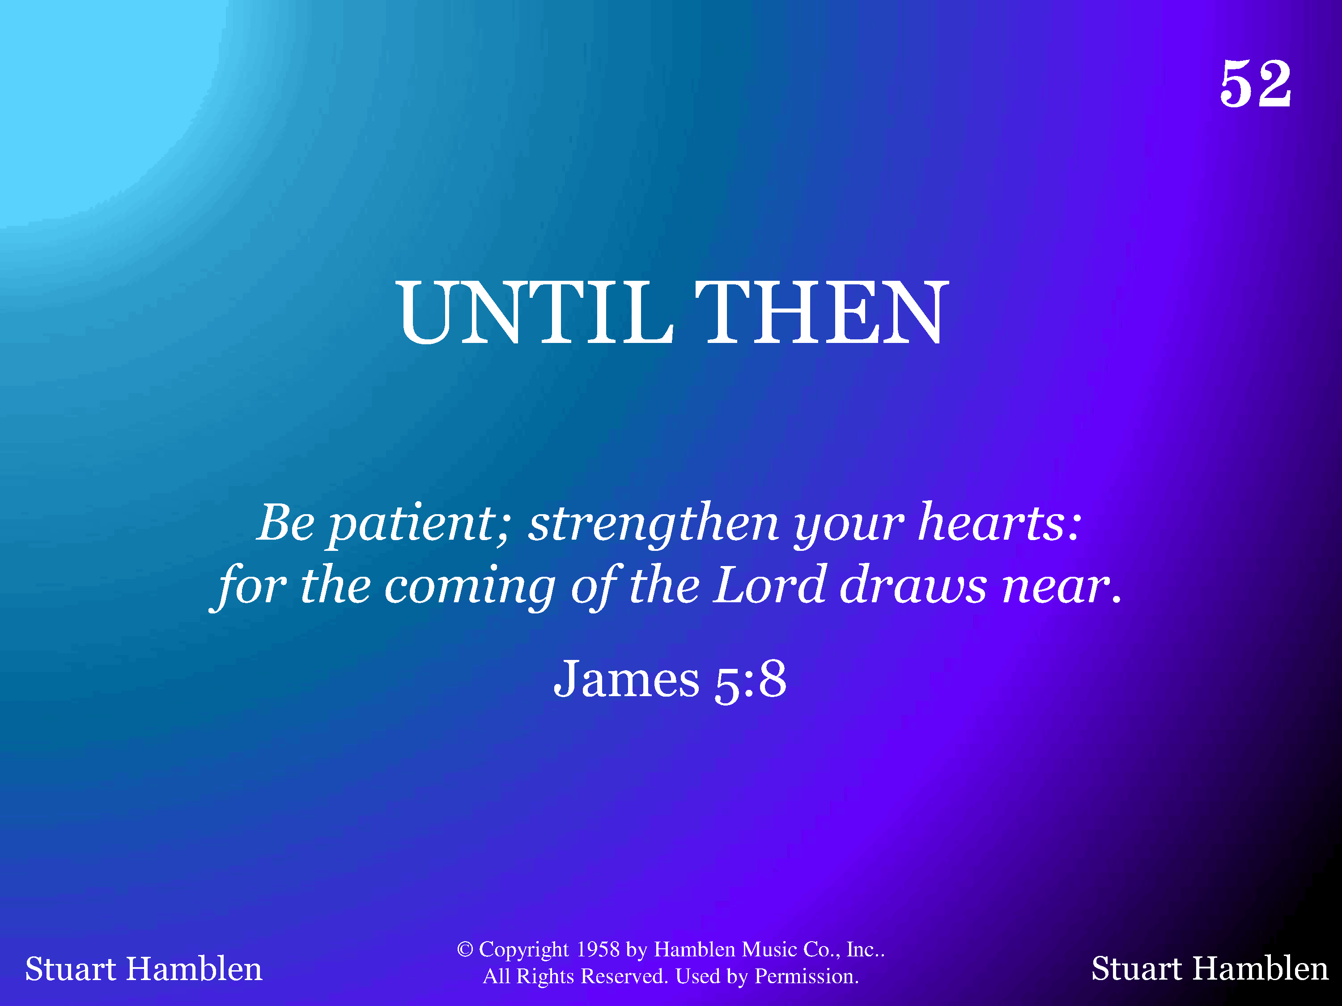
1052 - Until Then - Title

Slide 2
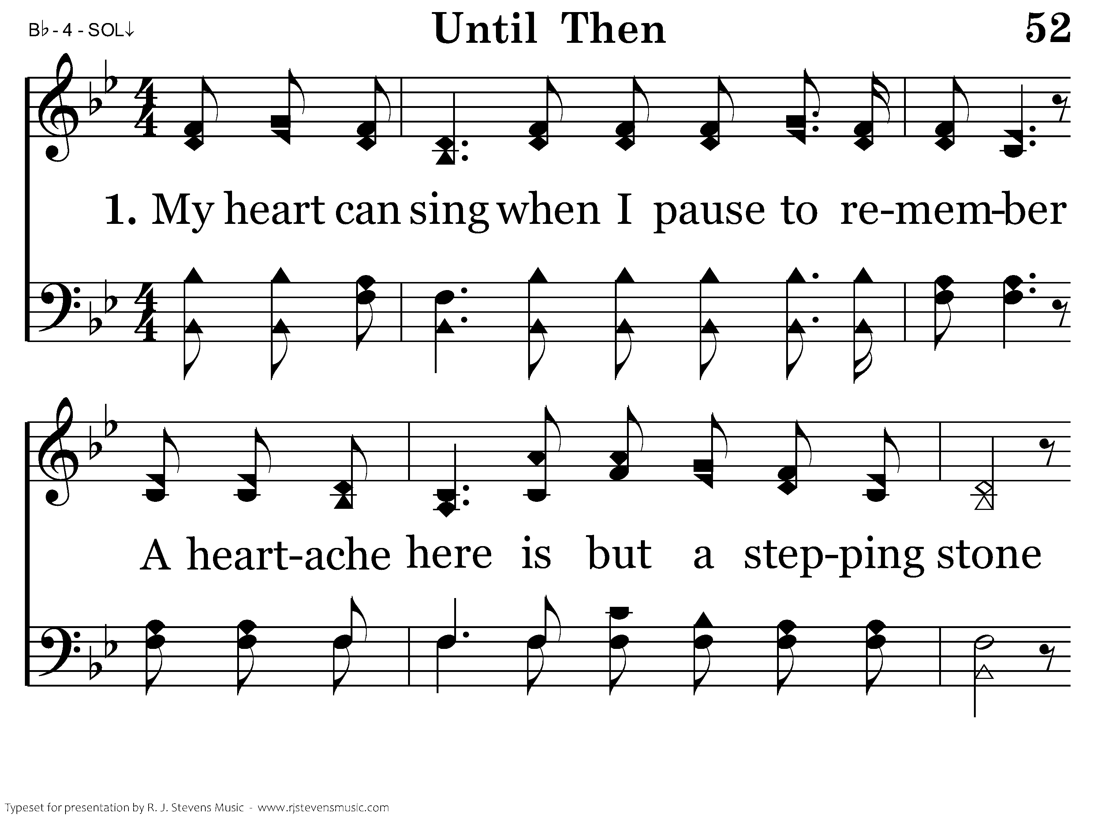
1052 - Until Then - 1.1

Slide 3
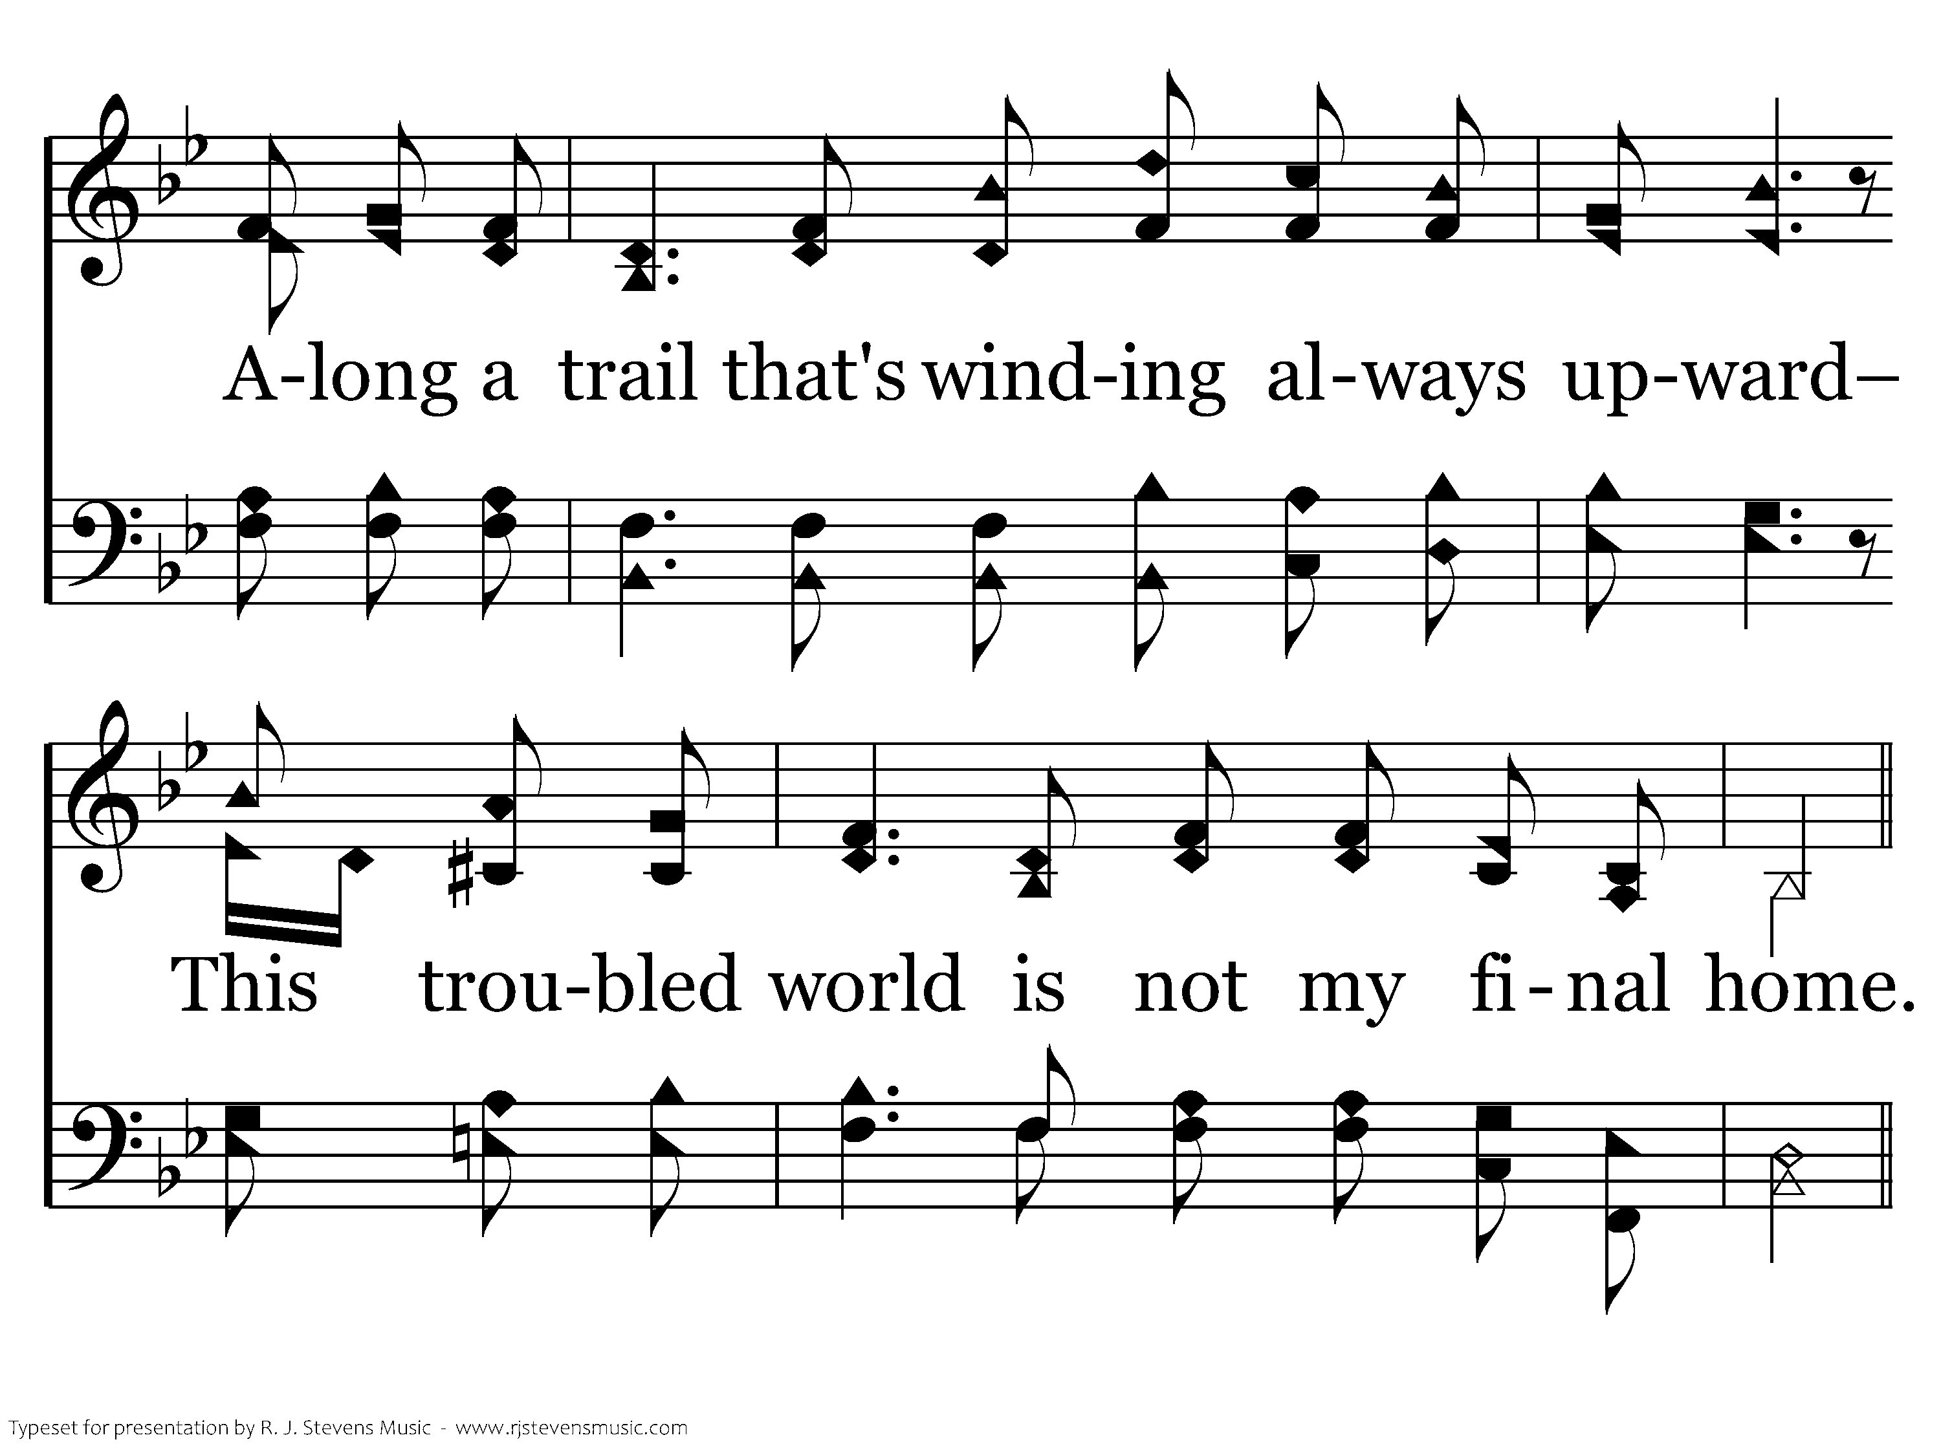
1052 - Until Then - 1.2

Slide 4
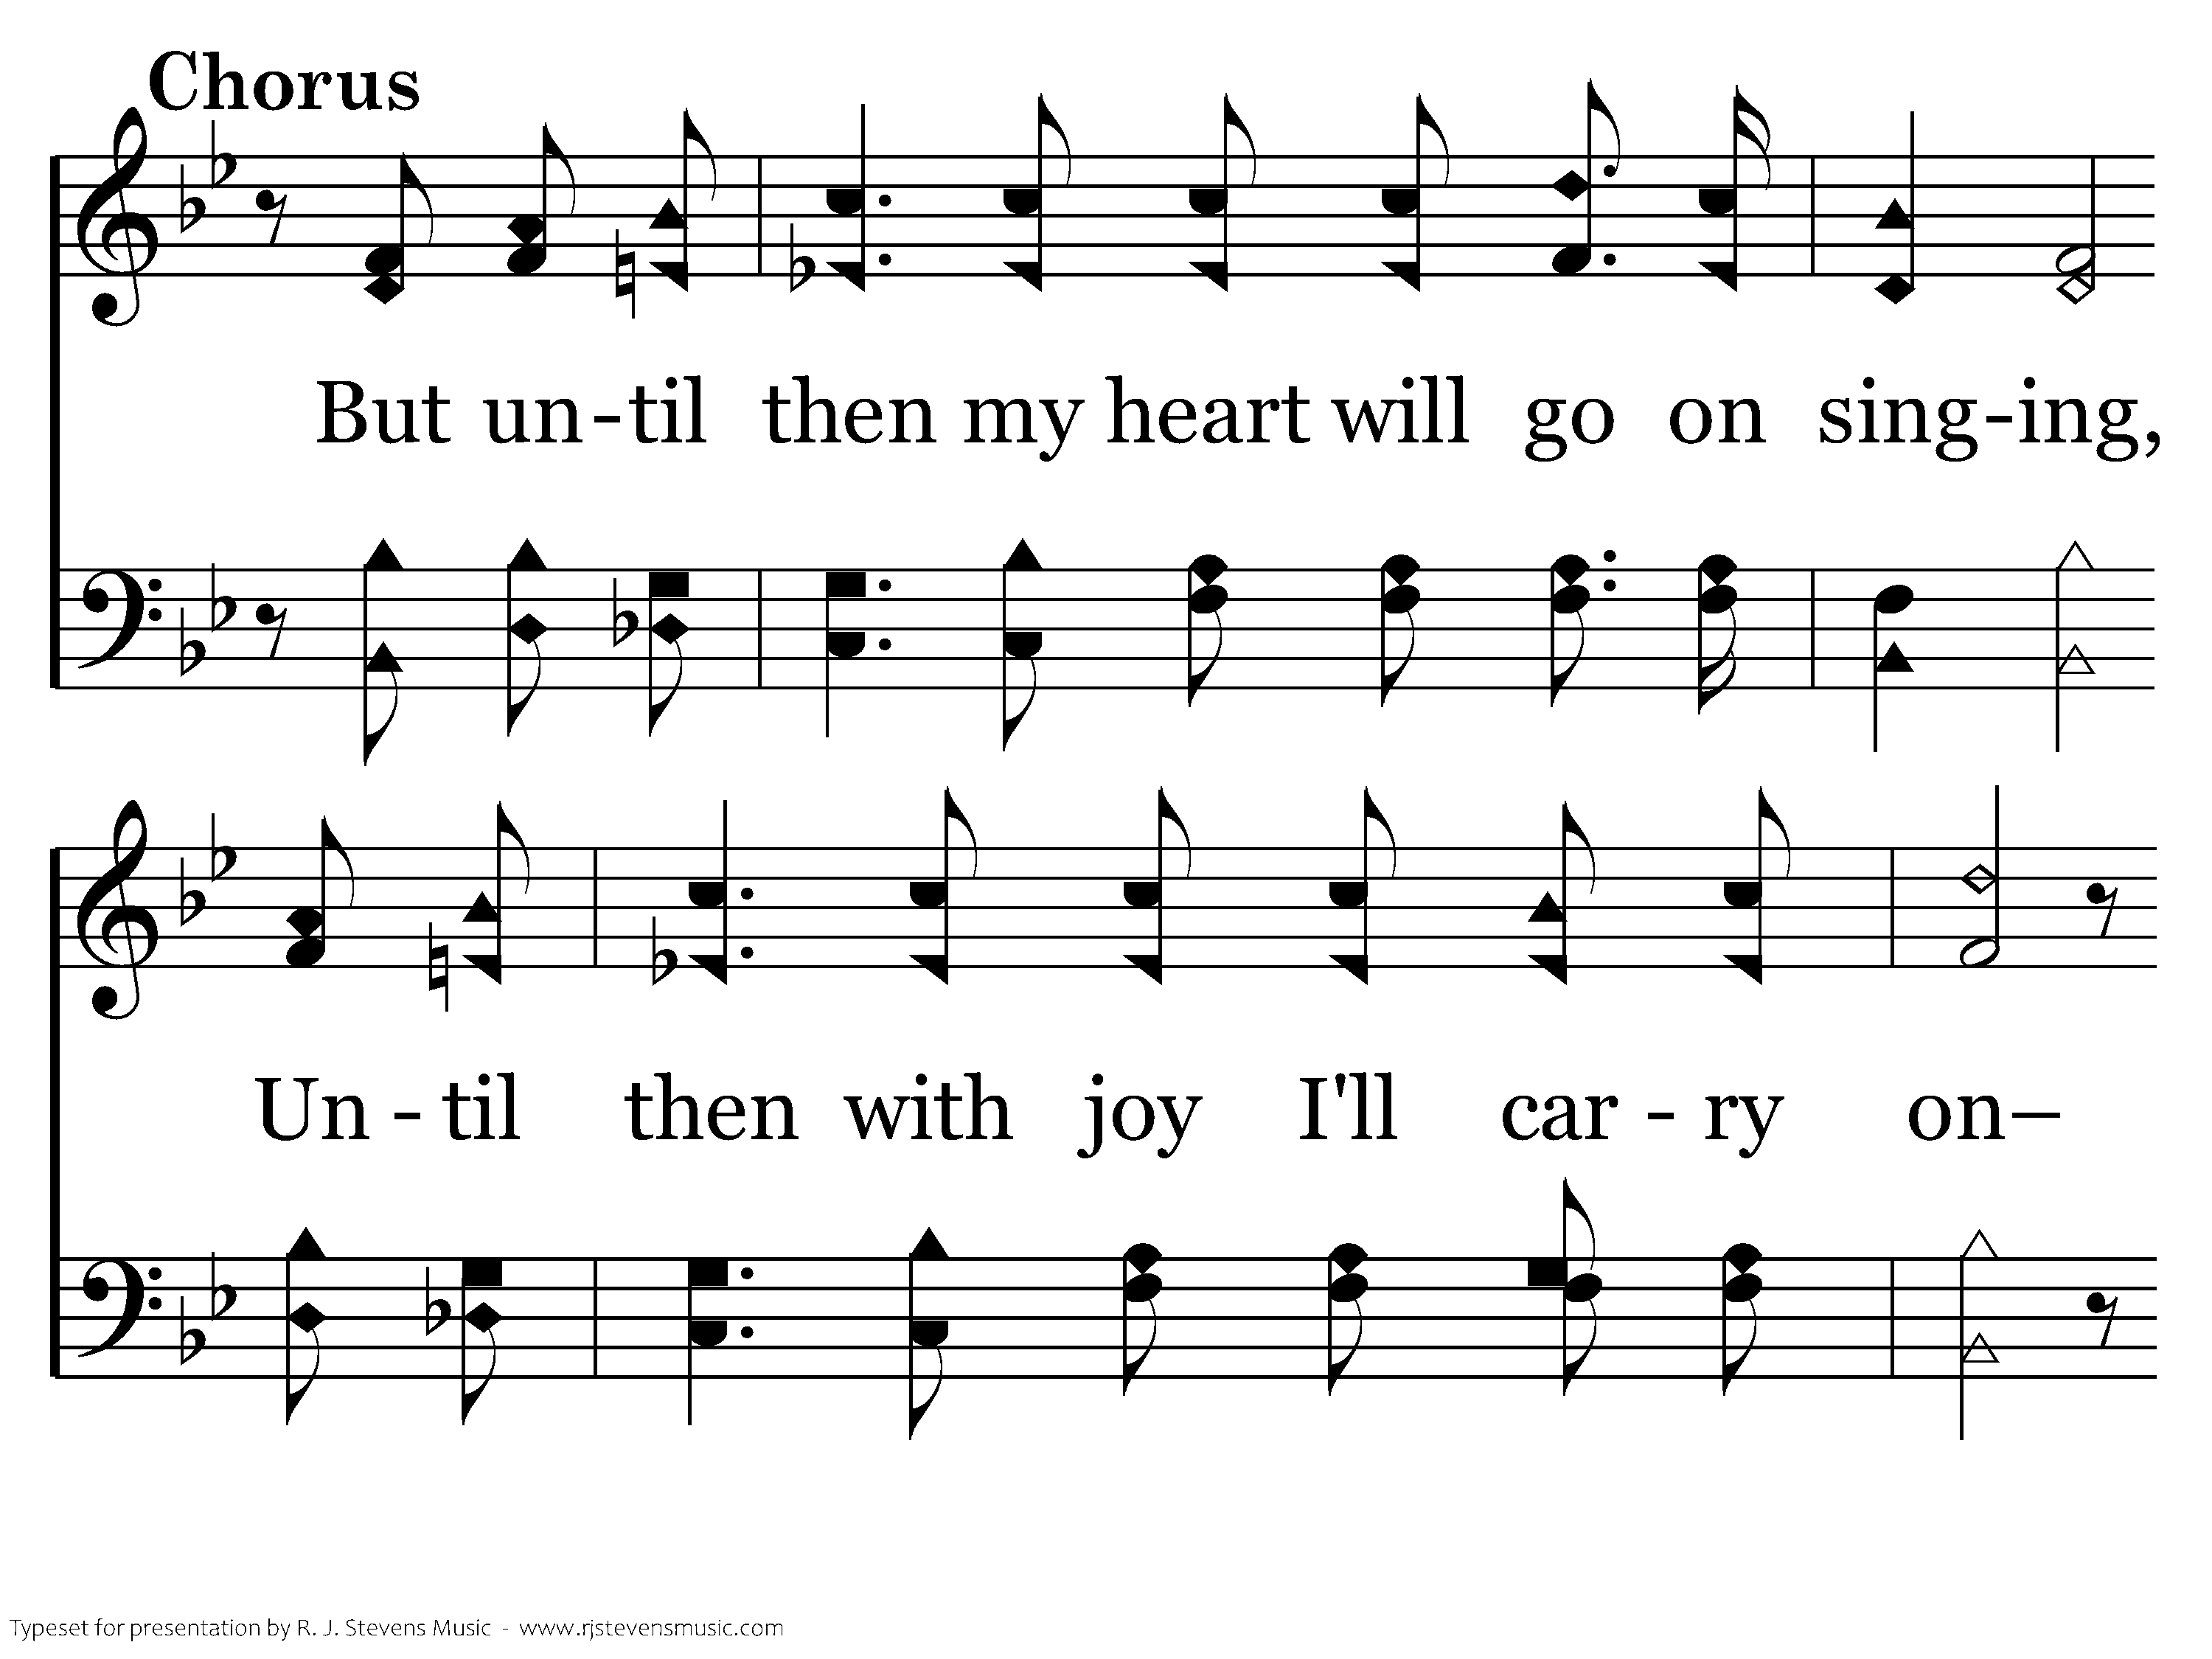
1052 - Until Then - C.1

Slide 5
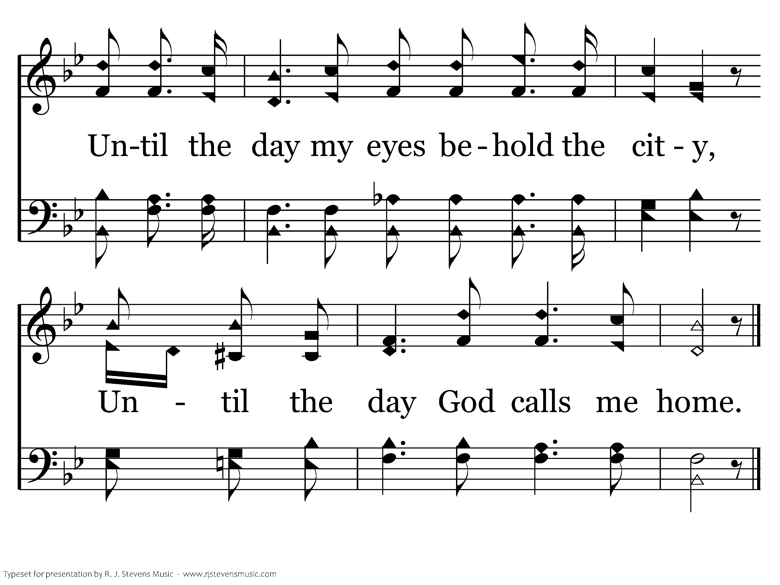
1052 - Until Then - C.2
End of Verse 1

Slide 6
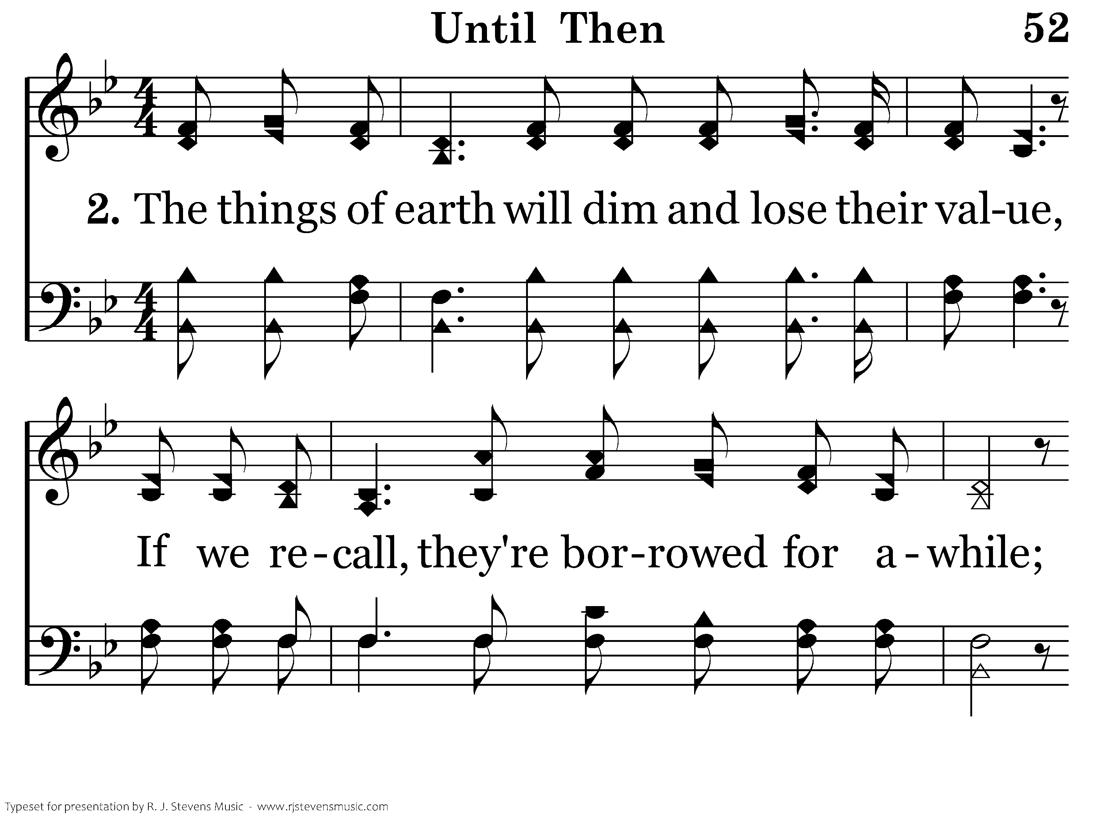
1052 - Until Then - 2.1

Slide 7
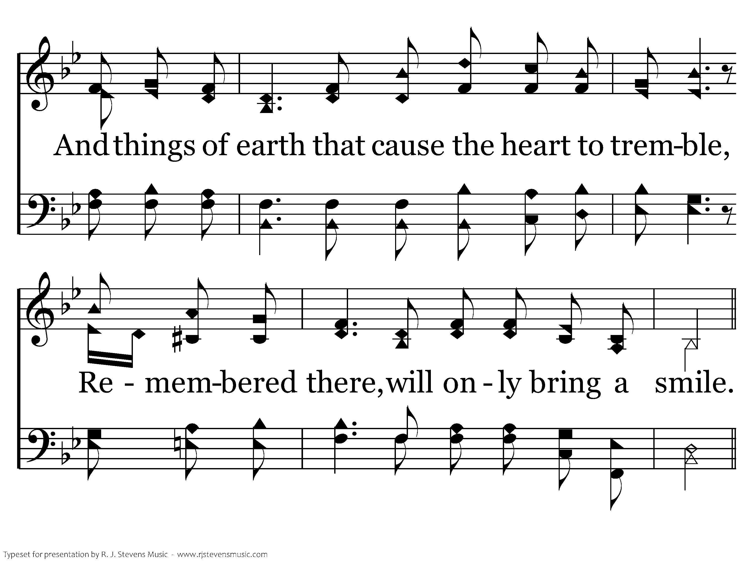
1052 - Until Then - 2.2

Slide 8
1052 - Until Then - C.1

Slide 9
1052 - Until Then - C.2
End of Verse 2

Slide 10
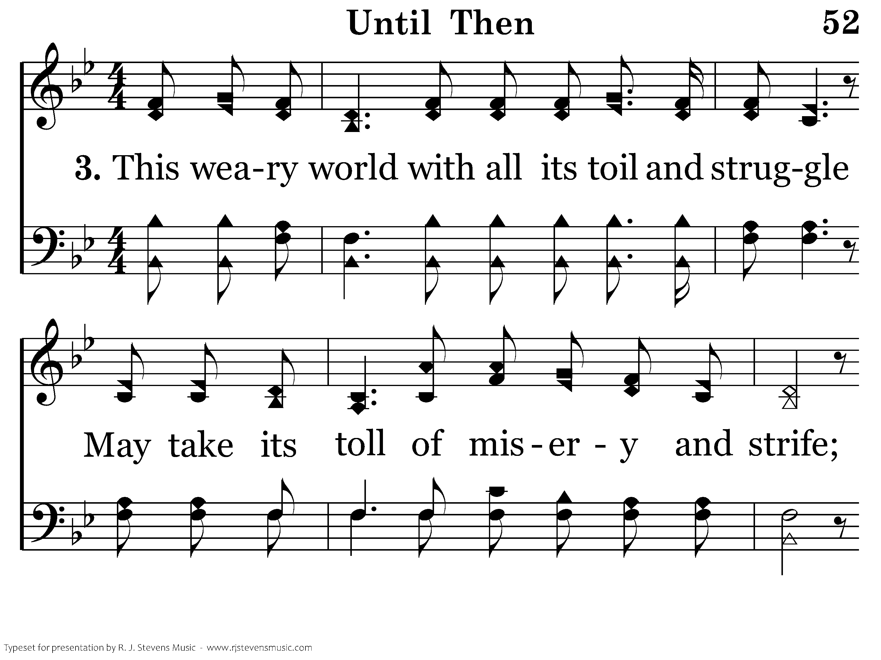
1052 - Until Then - 3.1

Slide 11
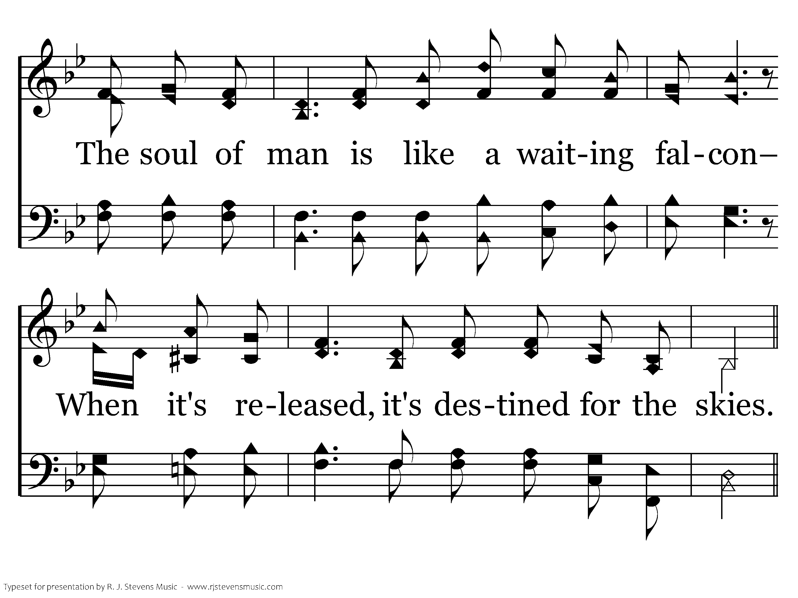
1052 - Until Then - 3.2

Slide 12
1052 - Until Then - C.1

Slide 13
1052 - Until Then - C.2
End of Song

