Slide 1
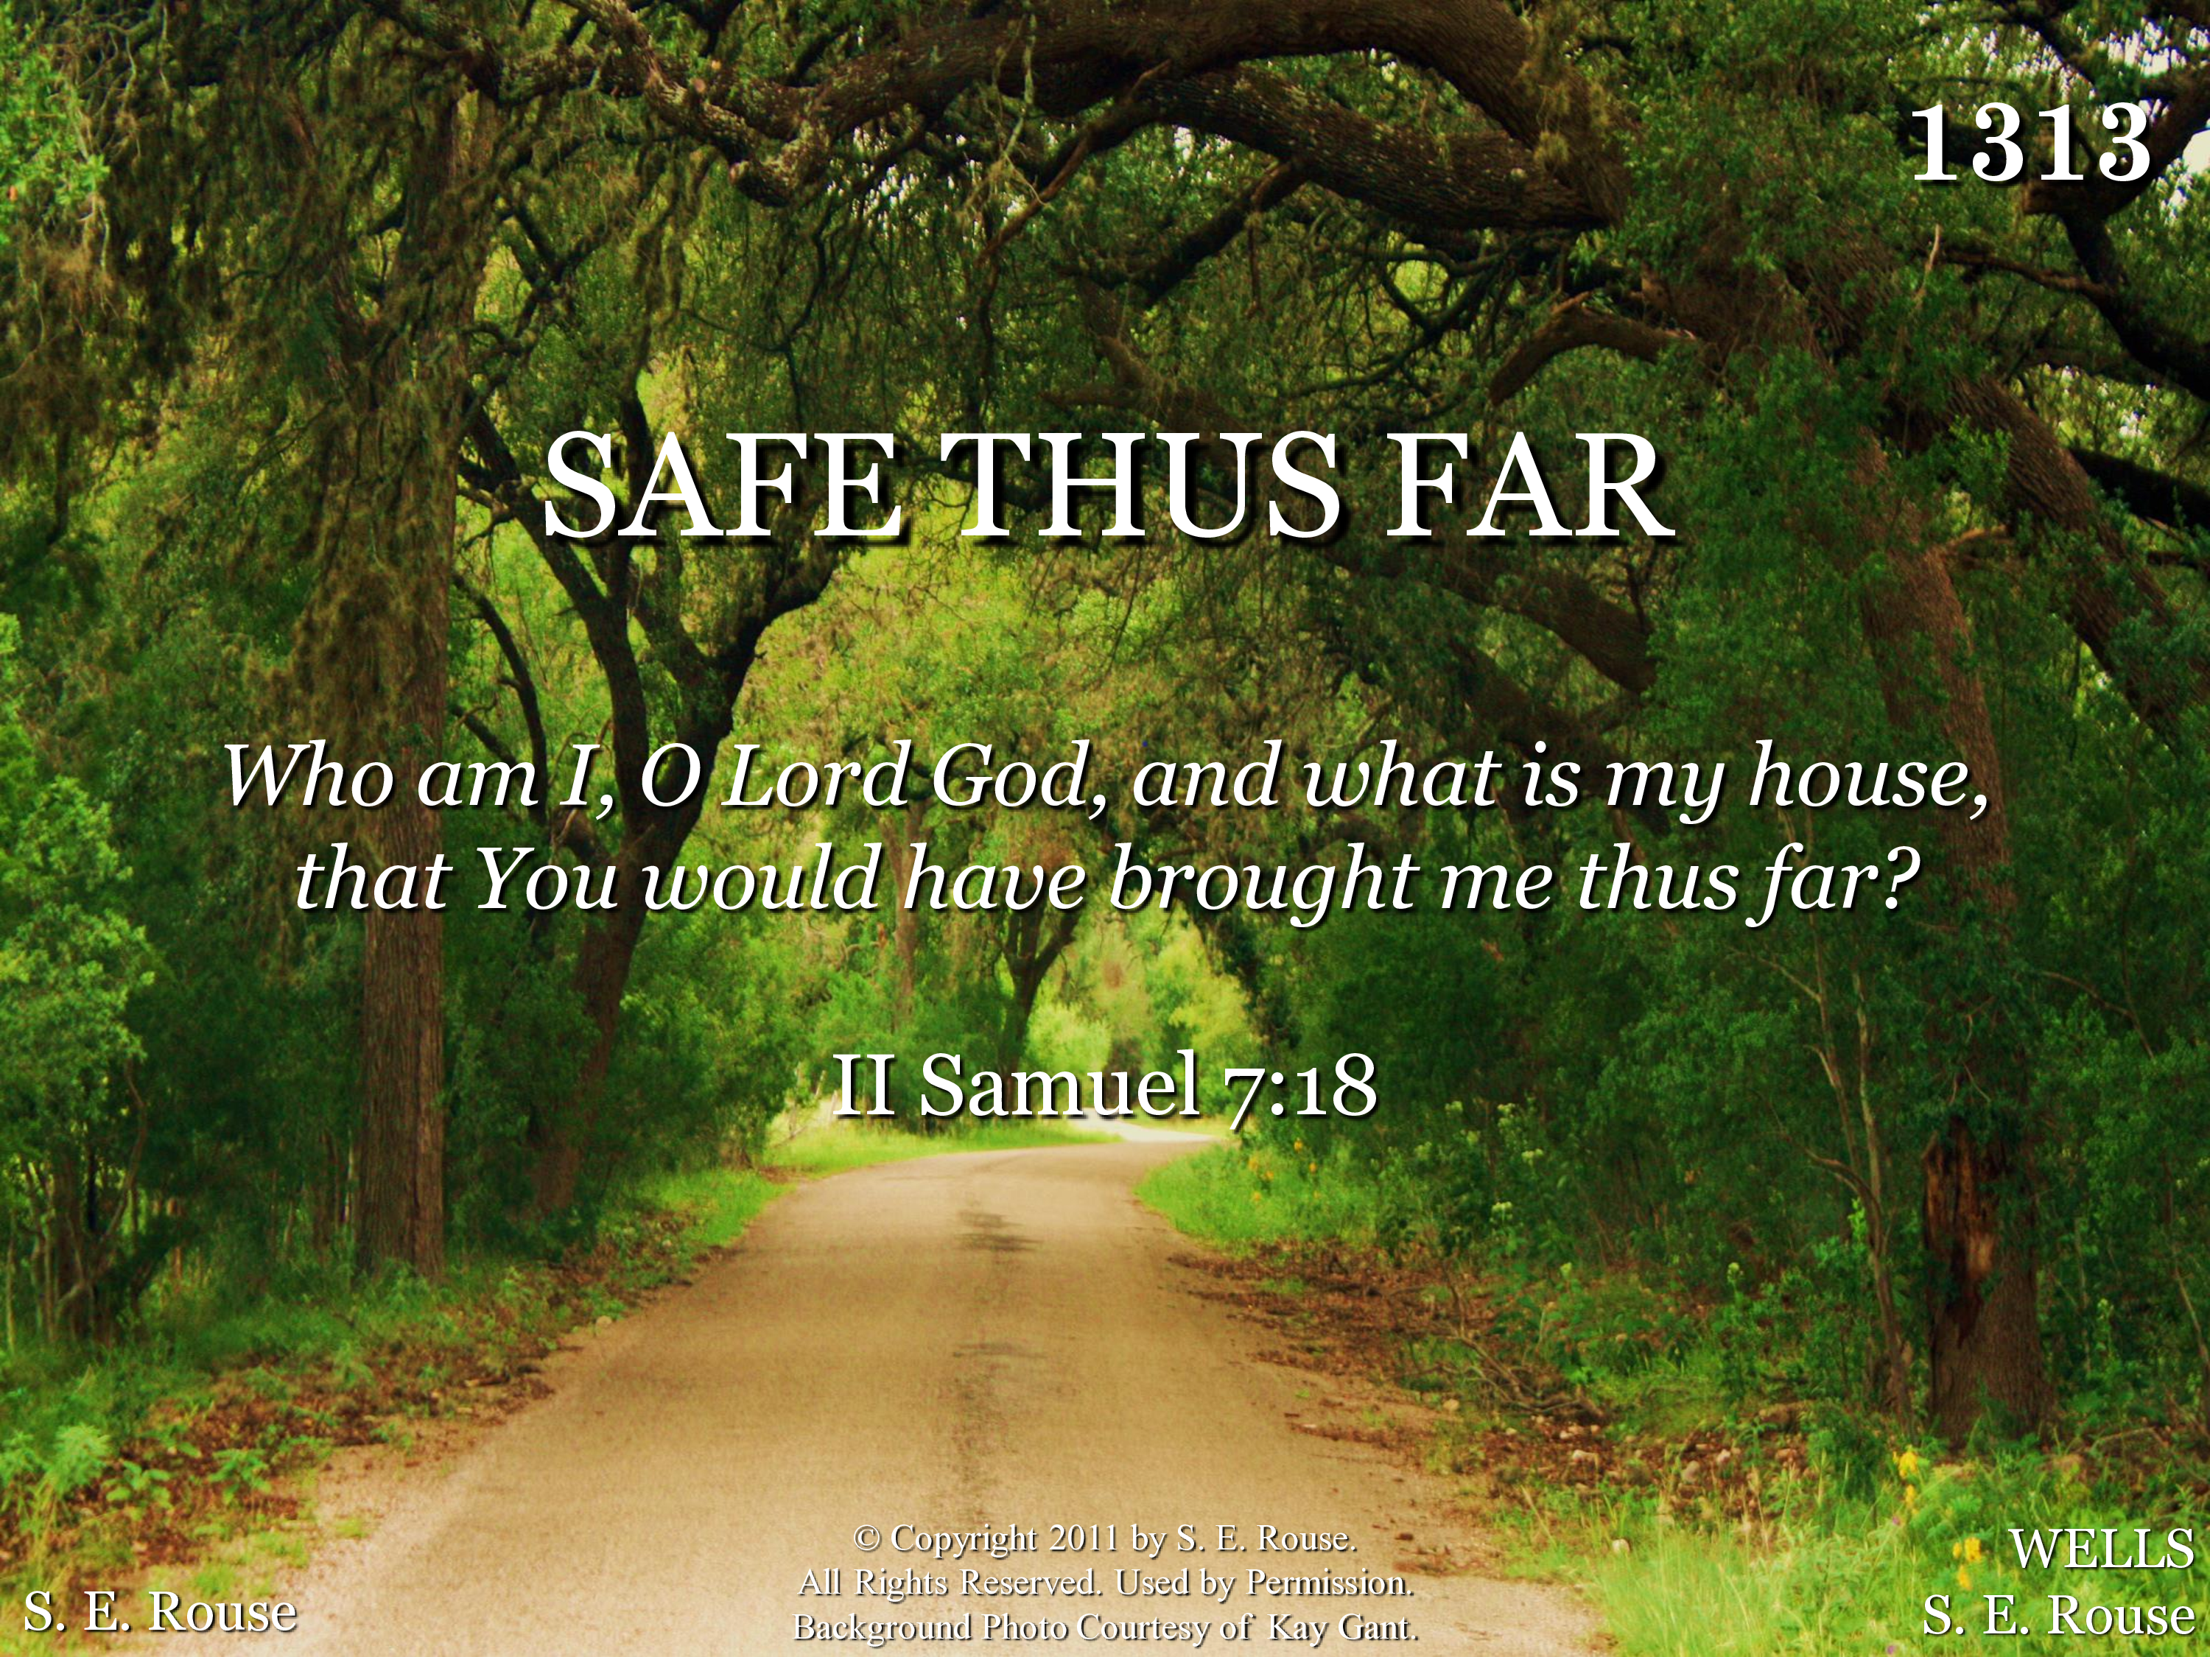
21313 - SAFE THUS FAR - Title

Slide 2
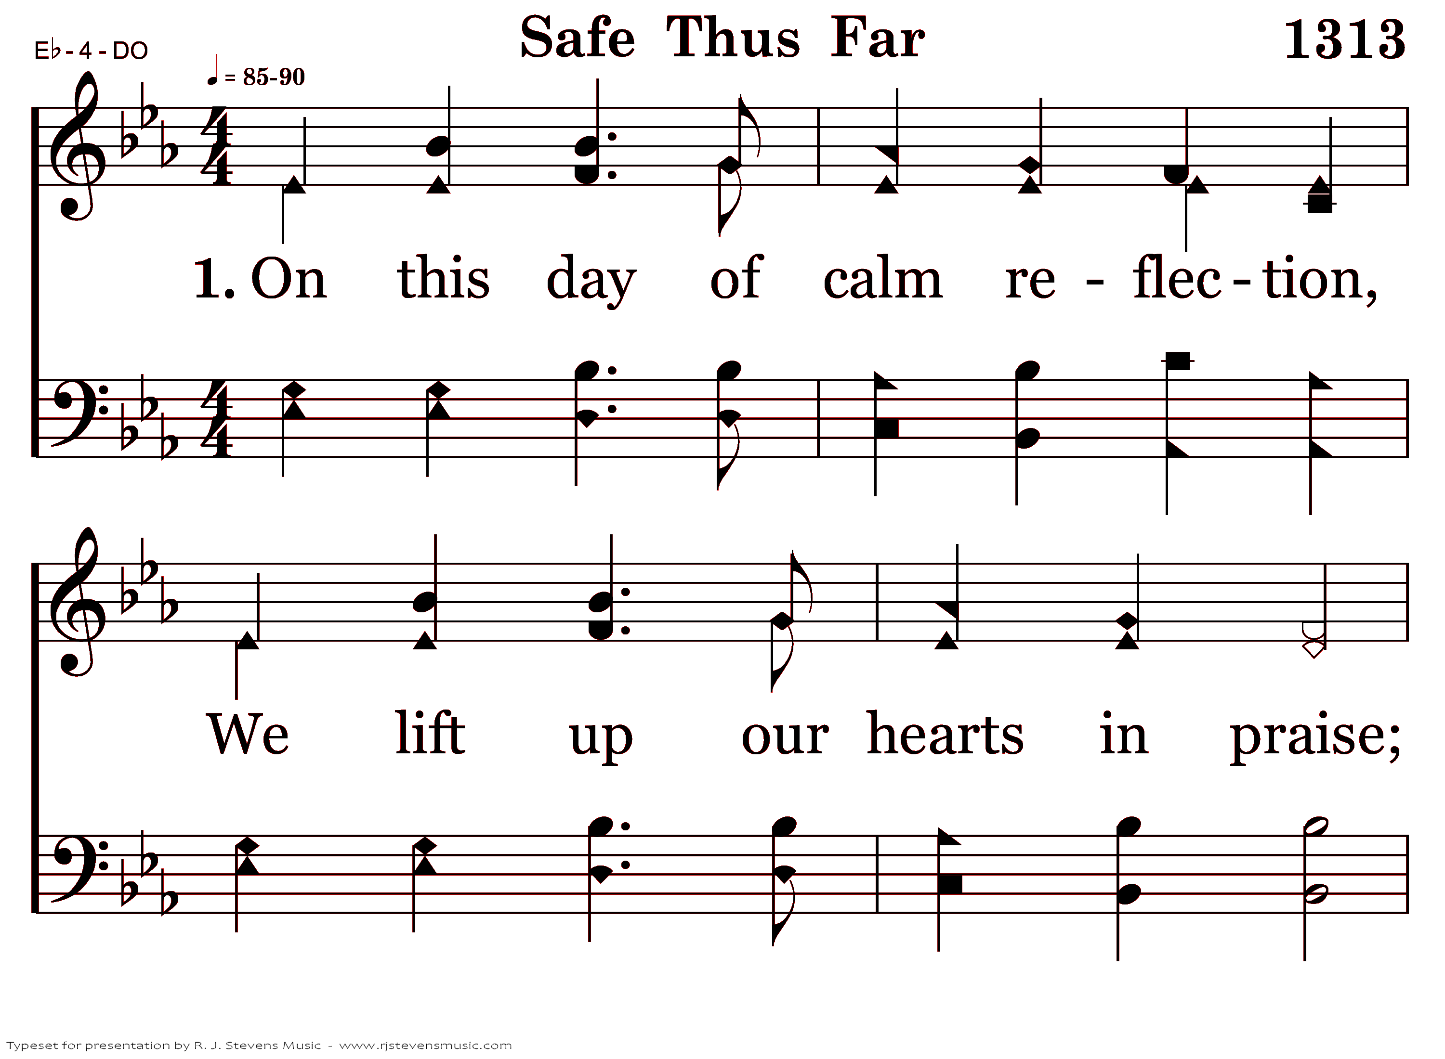
21313 - SAFE THUS FAR - 1.1

Slide 3
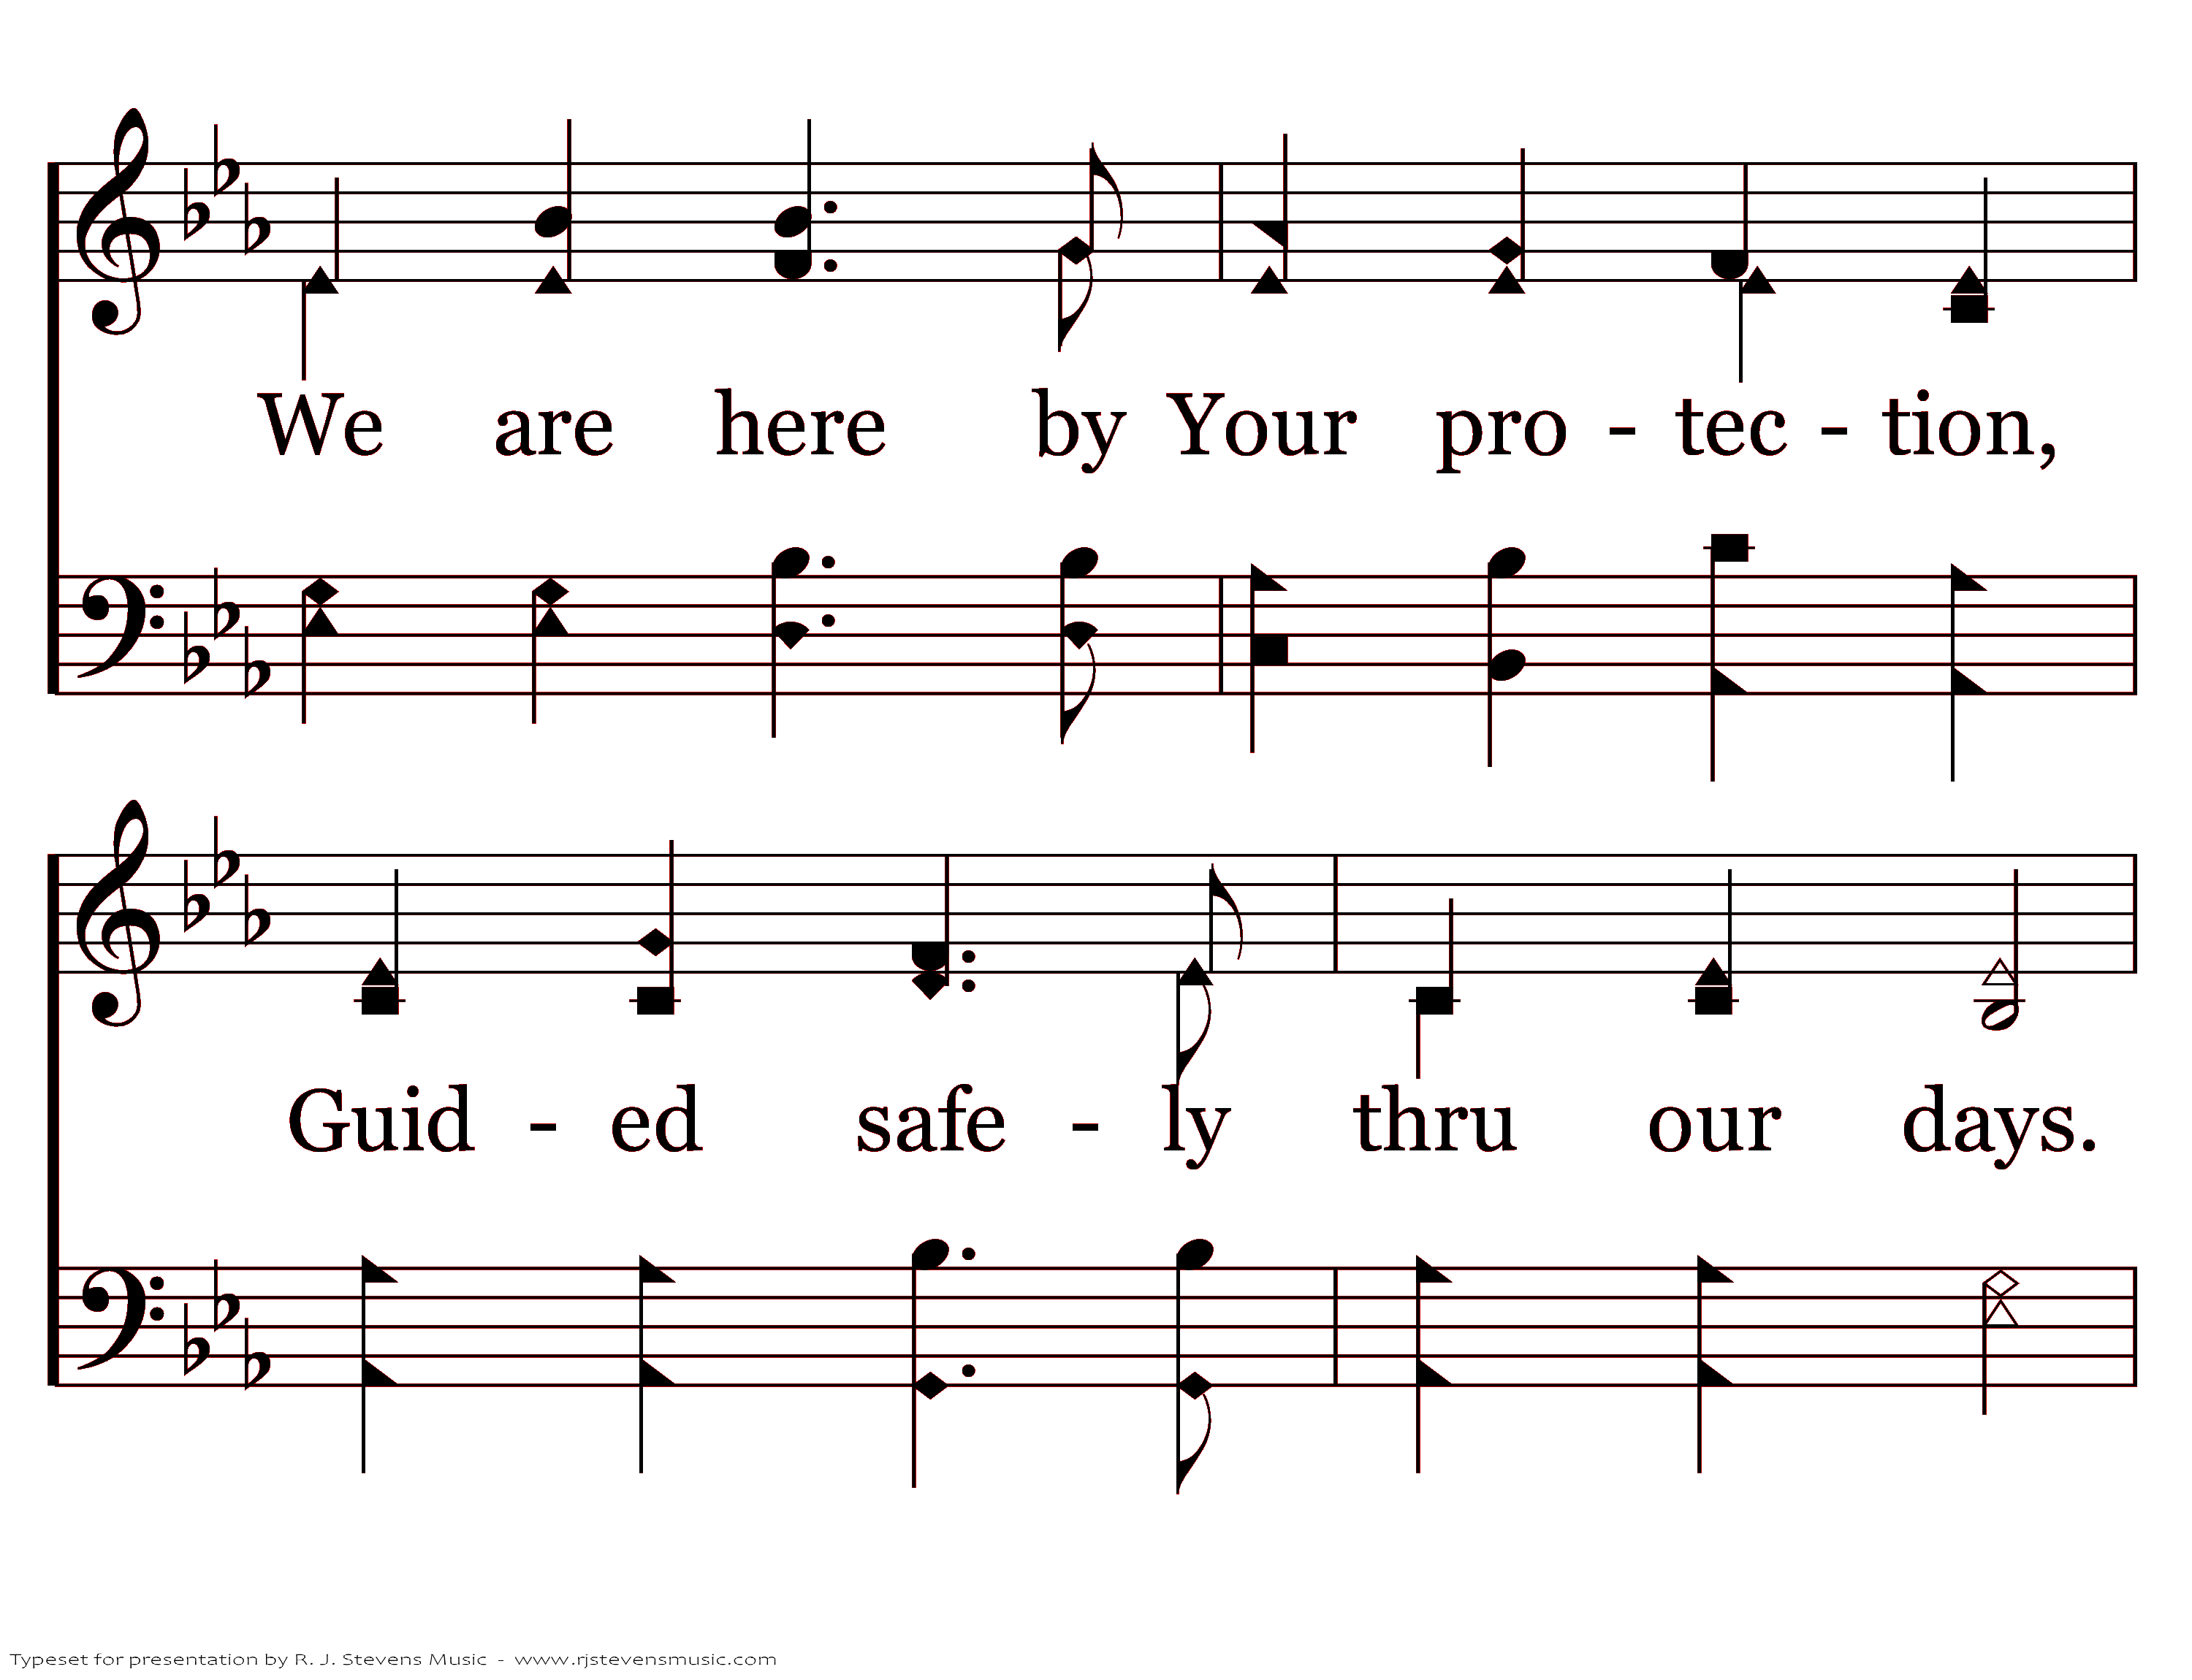
21313 - SAFE THUS FAR - 1.2

Slide 4
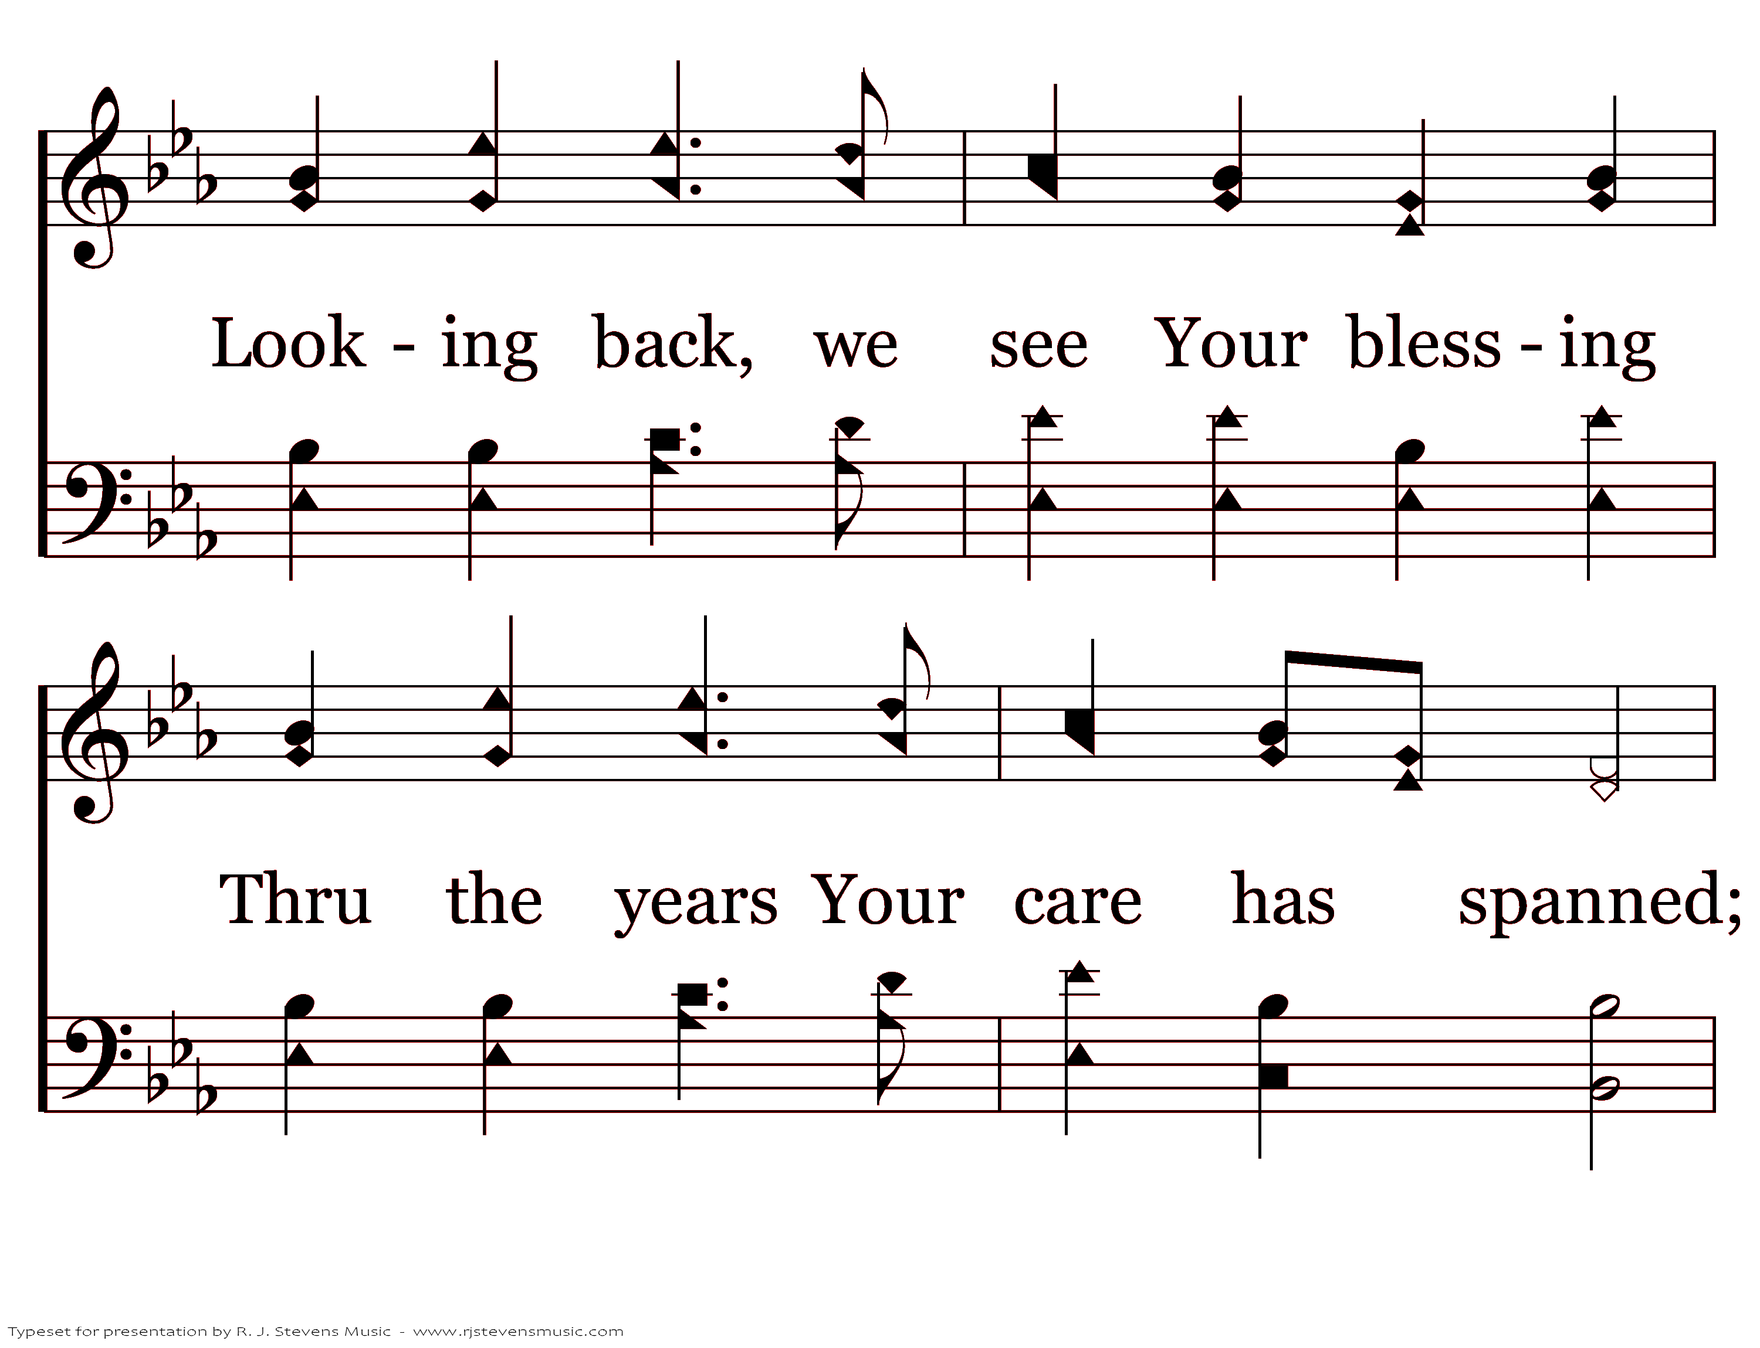
21313 - SAFE THUS FAR - 1.3

Slide 5
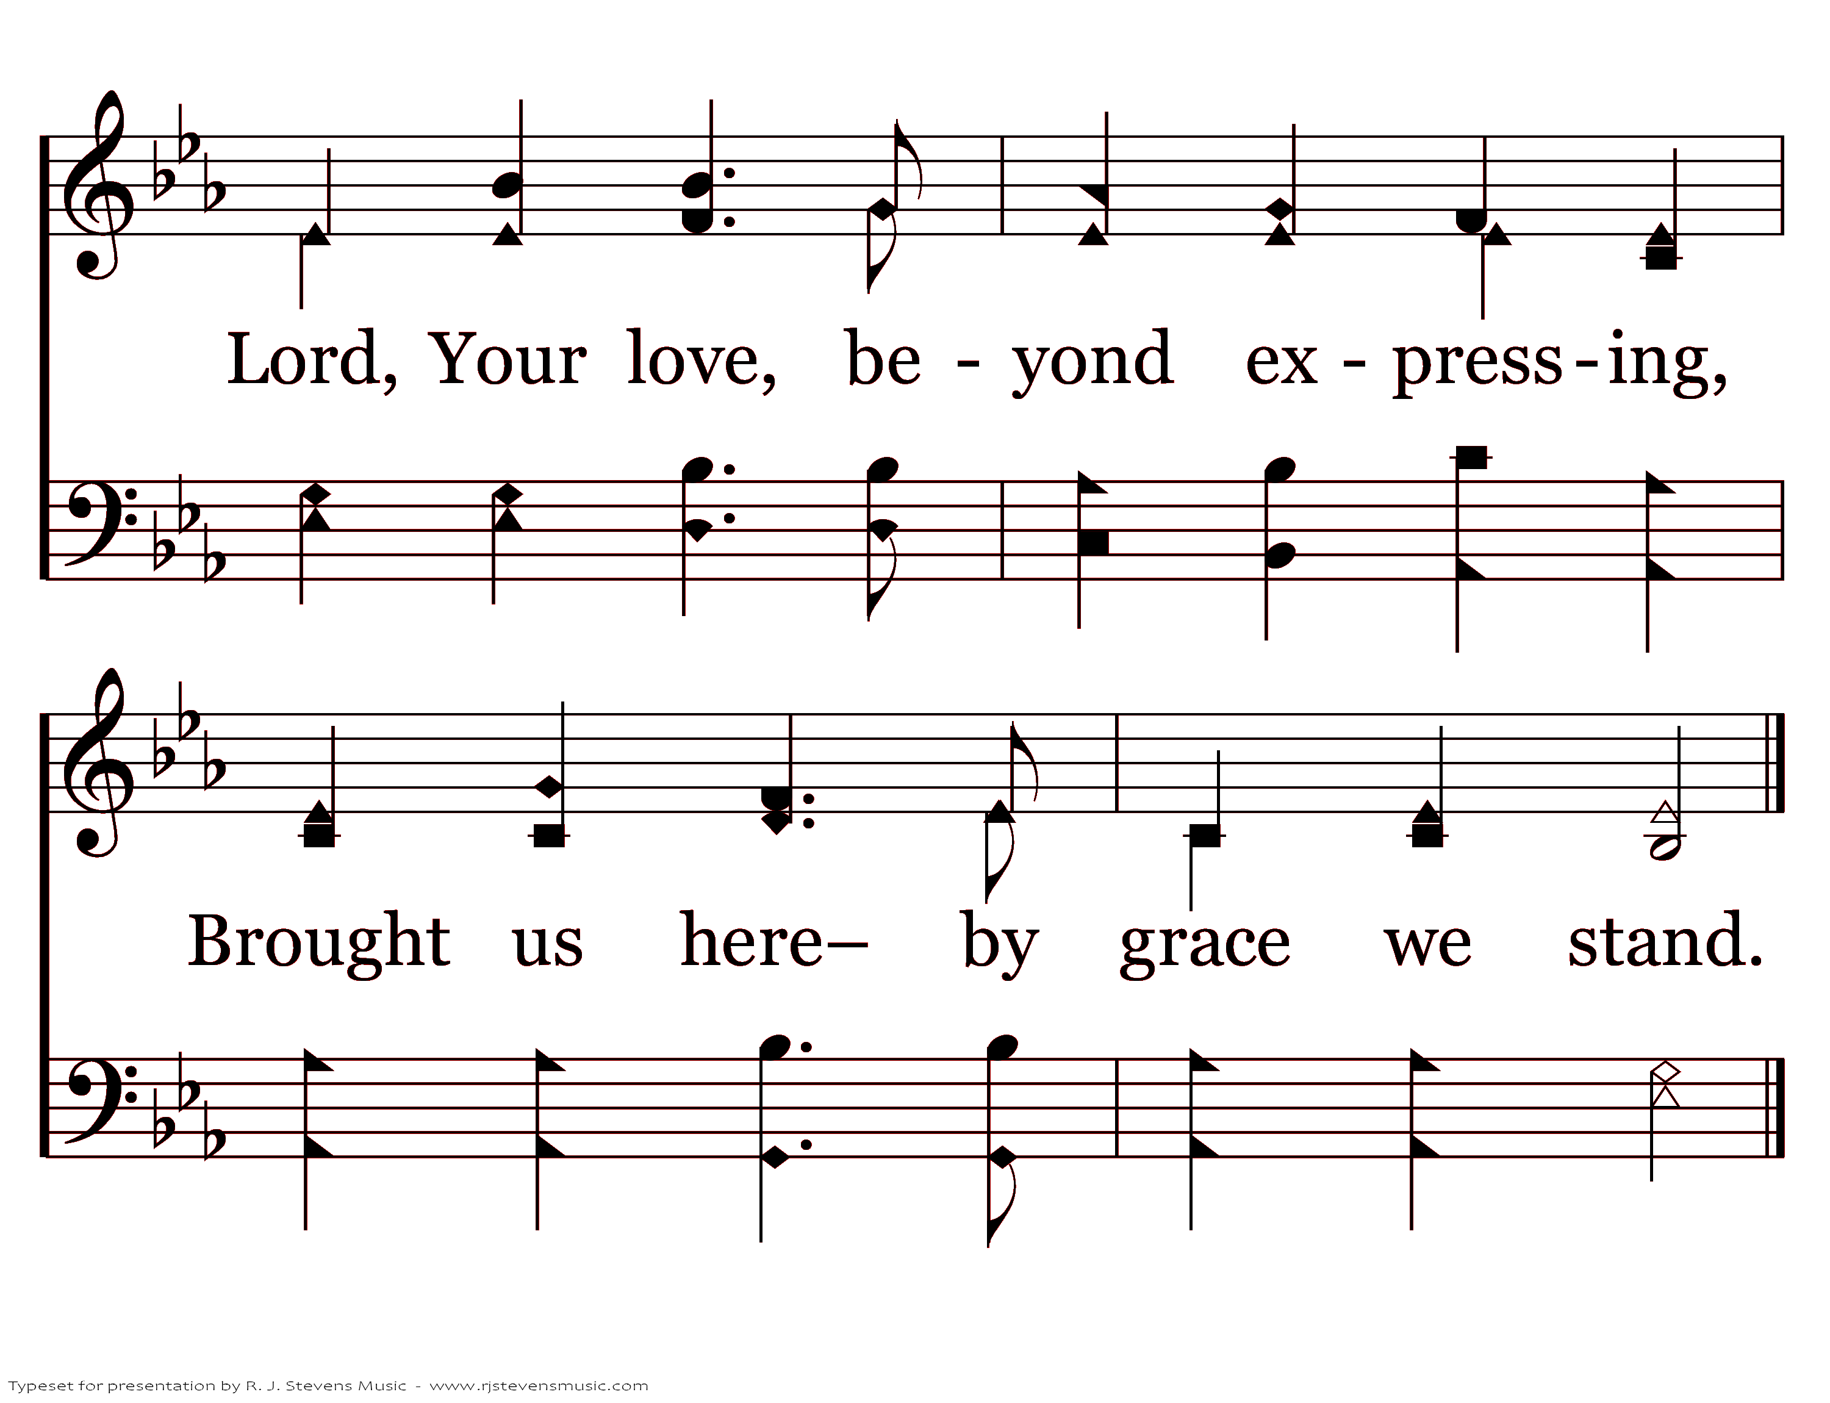
21313 - SAFE THUS FAR - 1.4
End of Verse 1

Slide 6
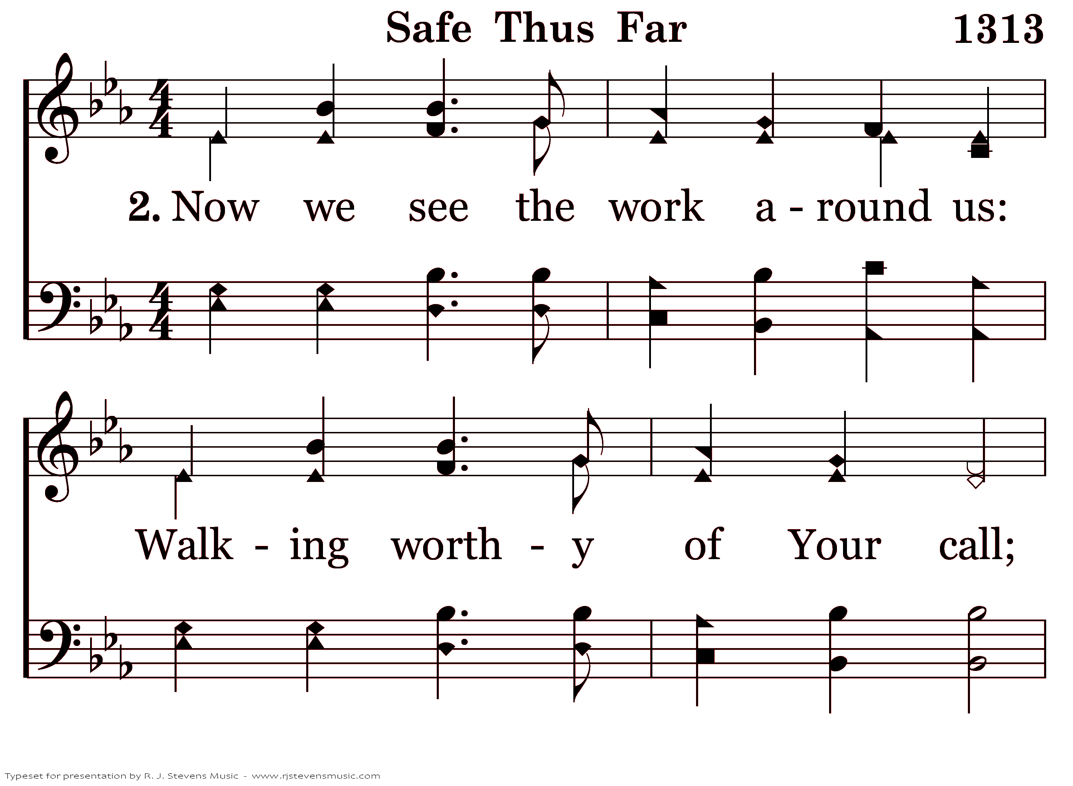
21313 - SAFE THUS FAR - 2.1

Slide 7
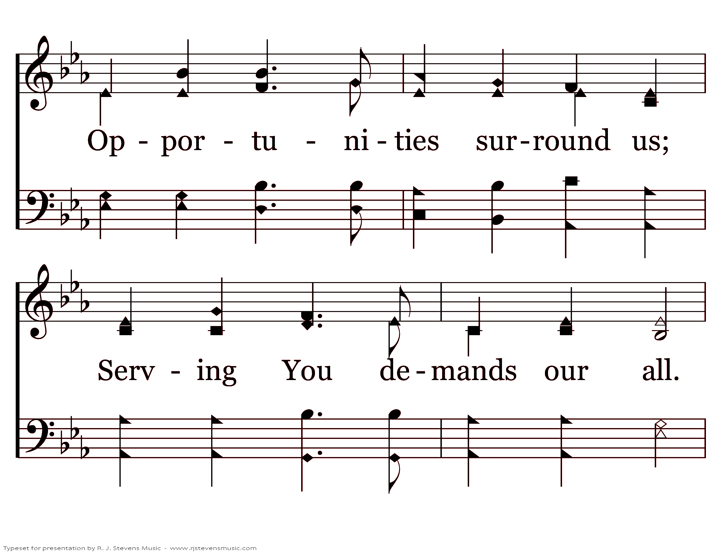
21313 - SAFE THUS FAR - 2.2

Slide 8
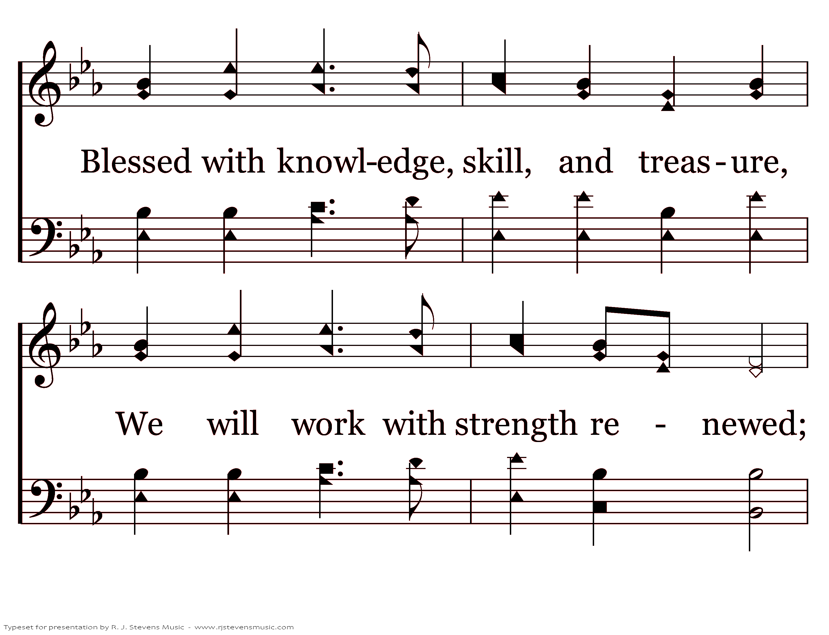
21313 - SAFE THUS FAR - 2.3

Slide 9
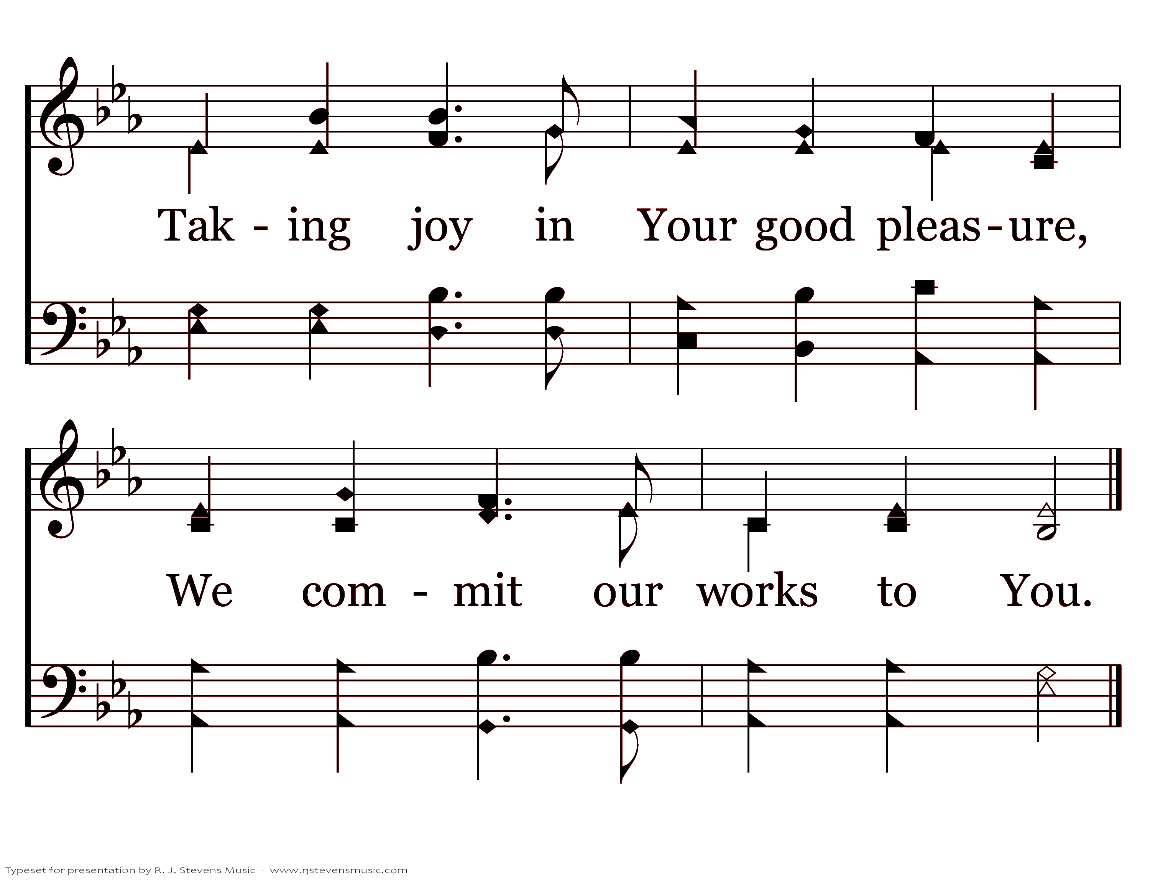
21313 - SAFE THUS FAR - 2.4
End of Verse 2

Slide 10
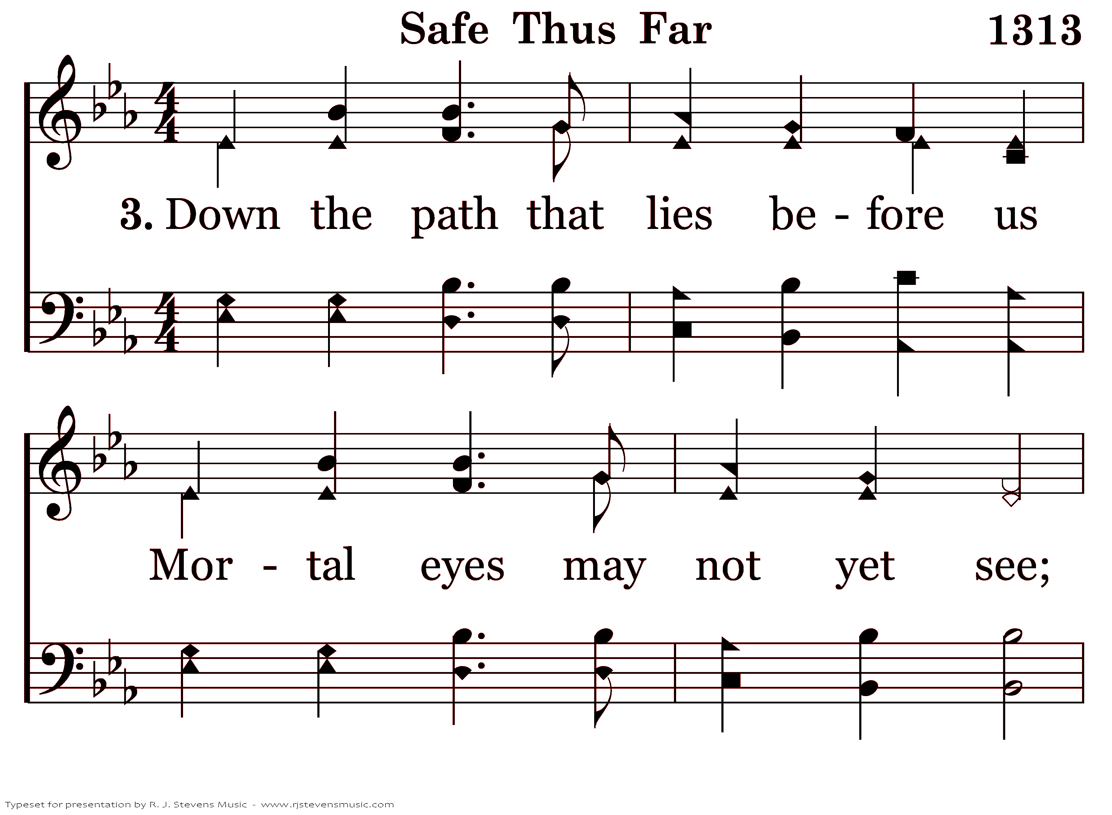
21313 - SAFE THUS FAR - 3.1

Slide 11
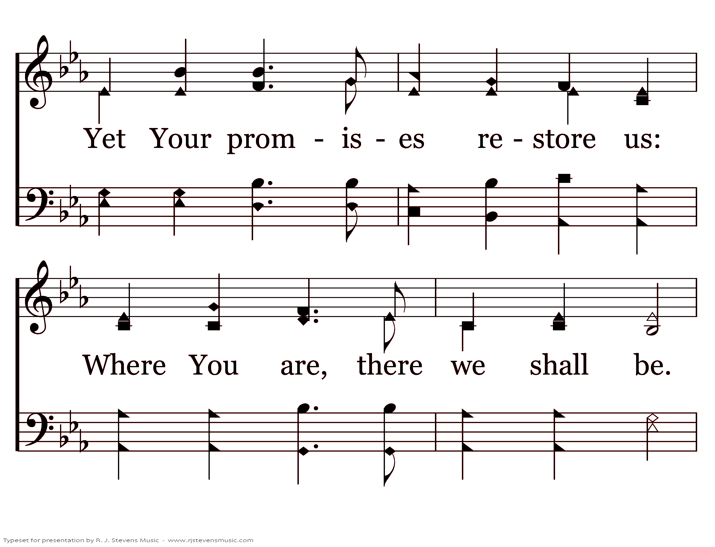
21313 - SAFE THUS FAR - 3.2

Slide 12
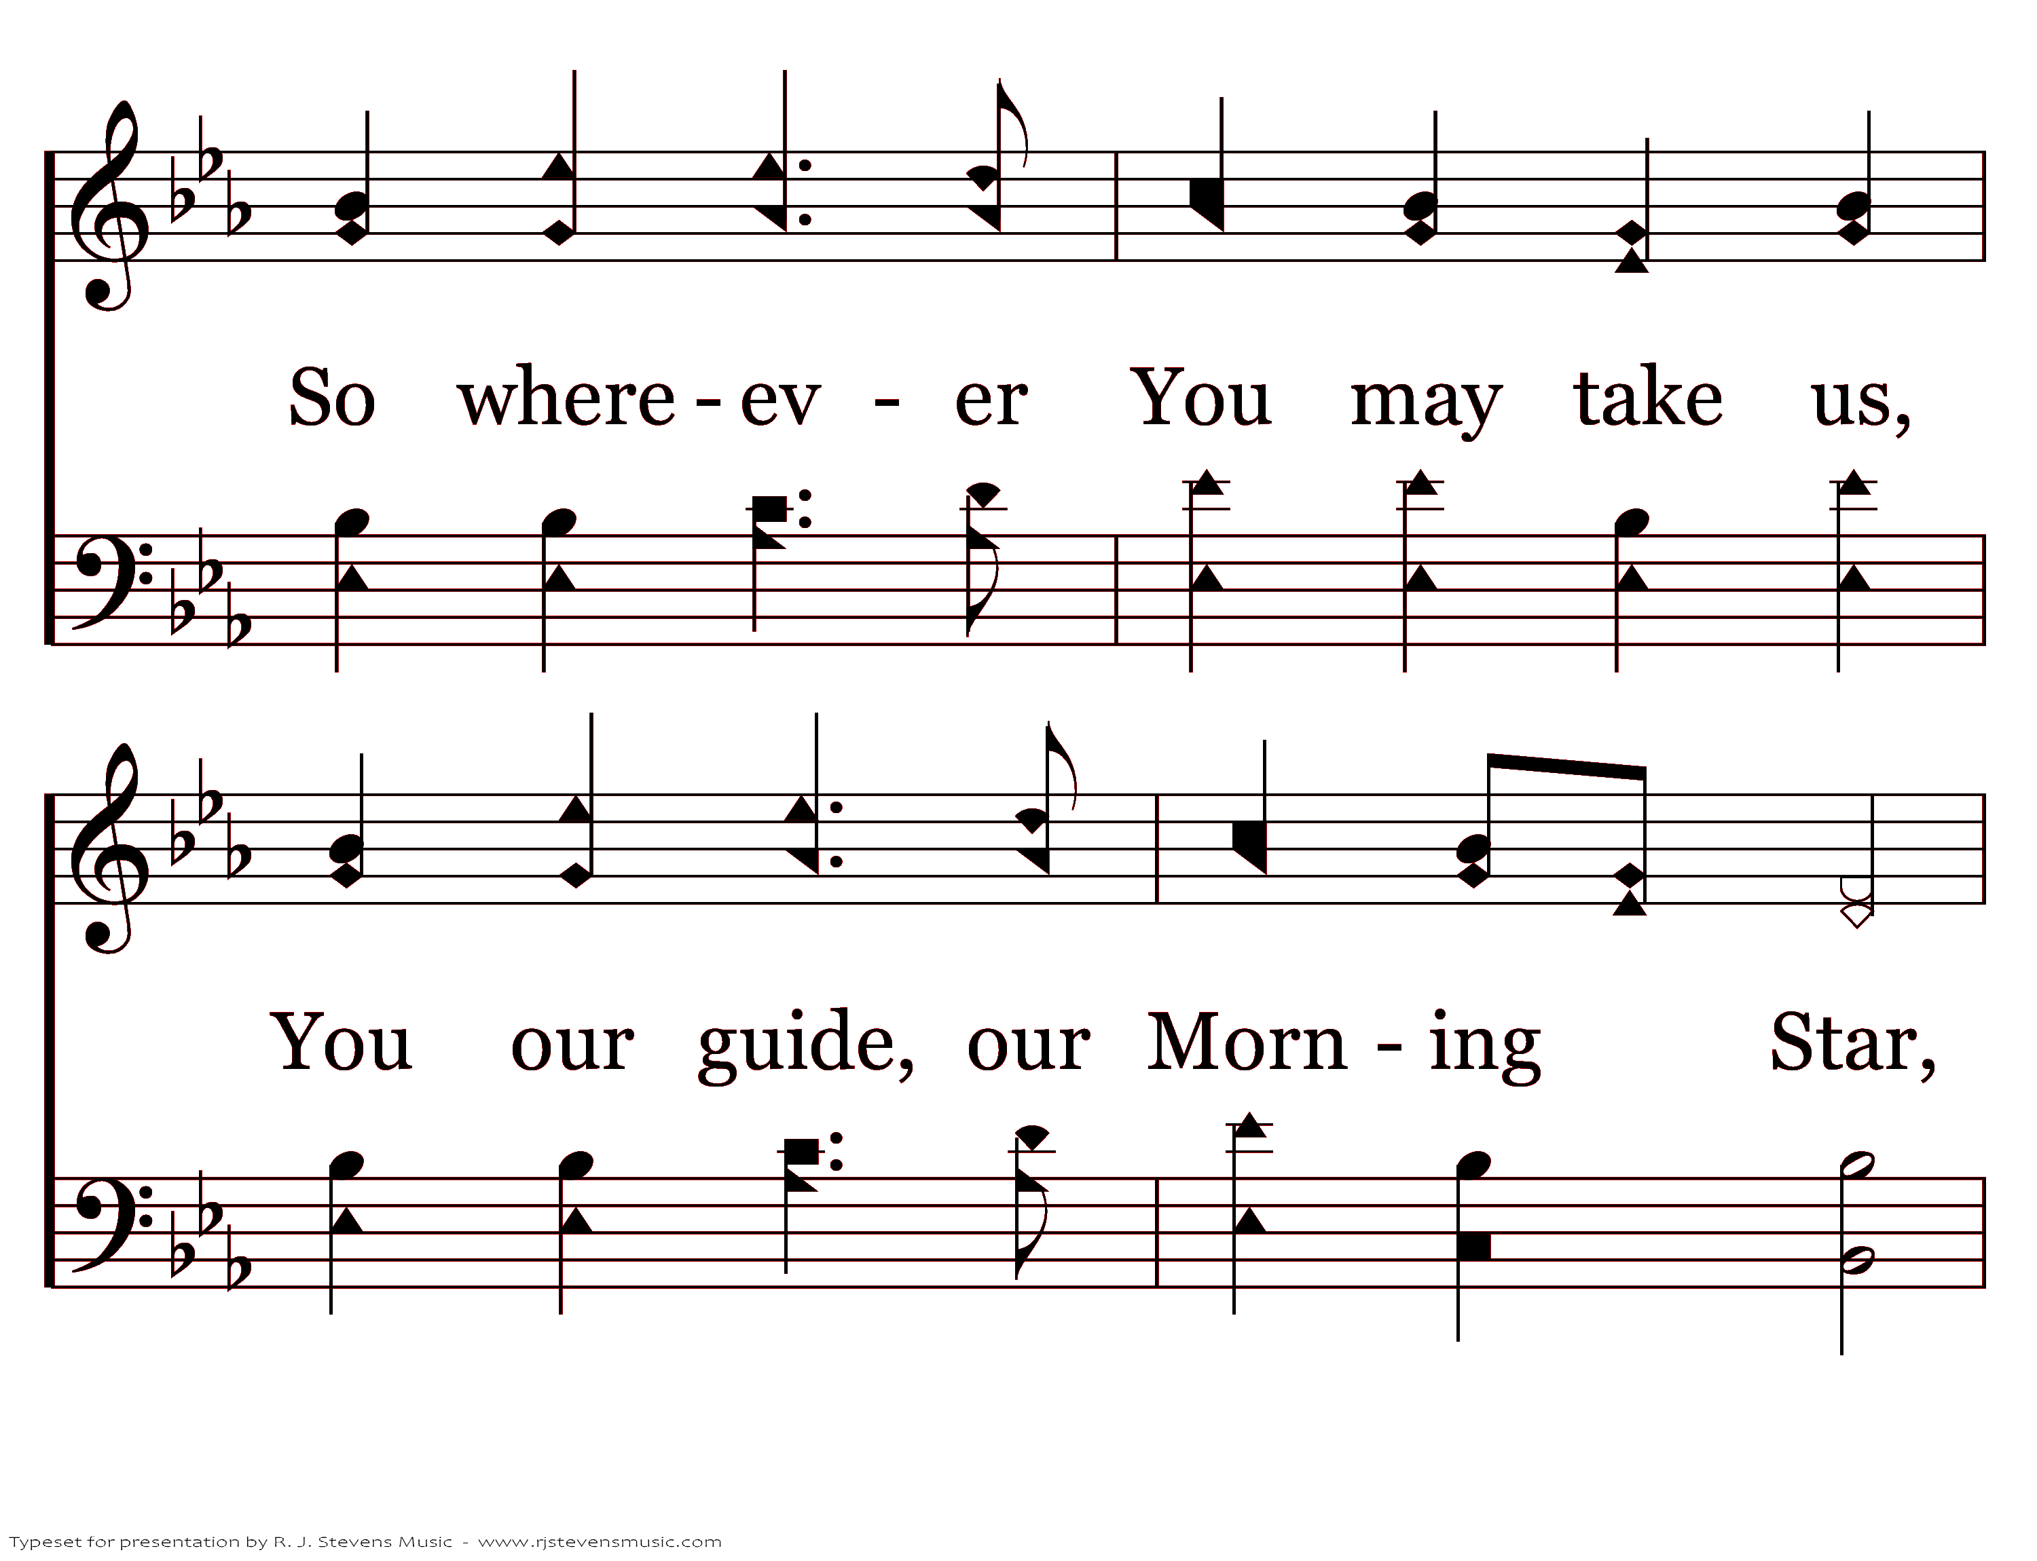
21313 - SAFE THUS FAR - 3.3

Slide 13
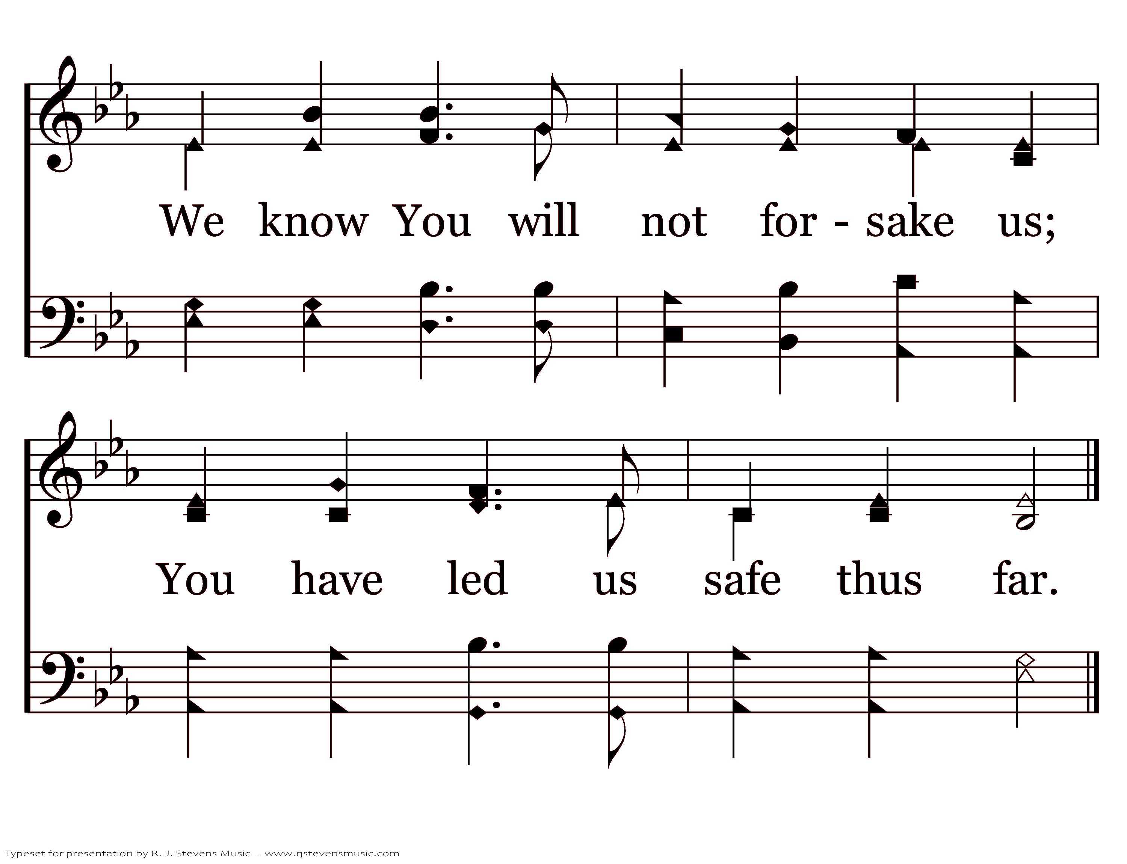
21313 - SAFE THUS FAR - 3.4
End of Song

